Slide 1


Slide 2
Advisor
Dr. Arshad Hussain
Co-Advisor
Engr. Kashif Ahmed Khan
Topic
Subgrade stabilization using lime and bagasse ash

Slide 3
Group Members
Nouman Rafique (Reg: 94)
Danish Umar (Reg: 21)
Khizar Farman (Reg: 41)

Slide 4
Sequence of presentation
Introduction
Research objectives
Results and Conclusion
Research methodology
Literature review
Research plan

Slide 5
Introduction
Agricultural country (fifth largest sugarcane producing country)
The problems faced by the agricultural sector and the rural communities are frequent power shortages and poor road infrastructure.
Cost effective solution for energy crisis: burning of agricultural byproducts (bagasse and rice husk) and coal
Producing 4 million tons of ashes per year
0.271 million ton bagasse ash per year
After research, it was interesting to know that these agricultural products are pozzolonic in nature
Utilization in road construction

Slide 6
Research objectives
Increasing the soil strength and load carrying capacity by soil stabilization techniques.
Reducing the swell potential of the subgrade soil.
Reducing the landfill volumes and the resulting contamination of the ground water.

Slide 7
Research Plan
Task 1 – Literature review
Task 2 – Materials collection
Task 3 – Detailed laboratory testing
Task 4 – Compilation of test results
Task 5 – Final report

Slide 8
Literature review
Title of the research | Objectives | Tests | Conclusion | Author & year
Physical Characteristics and Shear strength of Clay Stabilized using Lime and Bagasse Ash | In this study soil is stabilized using 8% lime and bagasse ash with variation of 0%, 3%, 6%, 9%, 12%, and 15% of the weight of the sample | Specific gravity, Water content, Atterberg limits, Sieve analysis, Hydrometer, and standard Proctor | Shrinkage limit increased, Improvement in compressive strength, mechanical and durability properties | Agus Susanto 2013
The use of sugarcane bagasse ash and lime to improve the durability and mechanical properties of compacted soil blocks | This study analyzes the use of lime and sugar cane bagasse ash (SCBA) as chemical stabilizers in compacted Soil blocks. | The blocks were tested for flexure and compression in a dry and a saturated state | The results indicate that blocks manufactured with 10% of lime in combination with 10% of SCBA showed better performance than those containing only lime | Rafael Alavez-Ramirez 2012

Slide 9
Title of the research | Objectives | Tests | Conclusion | Author & year
Waste Product ‘Bagasse Ash’ From Sugar Industry can be used as Stabilizing Material for Expansive Soils | Black cotton soil with partial replacement by Bagasse Ash (3%, 6%, 9% and 12%). |  | This paper highlights significant increase in properties of black cotton soil obtained at 6% replacement of Bagasse Ash without any chemical or cementing material. | Amit S. Kharade, 2014
Geotechnical properties of lateritic soil stabilized with sugarcane straw ash | Geotechnical properties of lateritic soil modified with bagasse ash. Cheaper, effective soil stabilizer | Geotechnical strength tests (compaction, California bearing ratio (CBR), unconfined compression test and triaxial | The results showed that sugarcane straw ash improved the geotechnical Properties of the soil samples. | Amu 2011

Slide 10
Title of the research | Objectives | Tests | Conclusion | Author & year
Feasibility Study of Improving Properties of Black Cotton Soil Using Industrial Wastes | Improving the properties of black cotton soil through addition of locally available industrial wastes as Foundry Sand, Rice Husk Ash and Bagasse Ash | Liquid limit, Standard proctor and CBR test | The liquid limit values of black cotton soil decreased after addition of waste material The CBR value of black cotton soil increased after addition of all three waste material Separately | Sanjeev Tanaji Jadhav 2014
California bearing ratio of expansive subgrade stabilized with waste materials | Industrial and agricultural wastes such as coal ash, groundnut shell ash and bagasse ash has been used as stabilizing agent | Optimum Moisture Content, Maximum Dry Density | The CBR value increased from 1.63% for native soil to 7.87%, 6.79% and 7.88% by using various combinations | C. RAJAKUMAR, 2014

Slide 11
Research methodology
Materials selection and collection
Material characterization
Moisture optimization
Unconfined compressive strength test
California bearing Ratio Test

Slide 12
Materials selection and collection
Soil was obtained from express highway near shwala
Bagasse ash was taken from “Chanar sugar mills tandlianwala Dist. Faisalabad”
Lime (Local Market Islamabad)

Slide 13
Material characterization
For soil characterization following tests were conducted
  Specific gravity (ASTM D 854-14)
  Grain size distribution (ASTM D 422)
  Atterberg limits (LL and PL) (ASTM D4318-10)

Slide 14
Material characterization
For characterization of bagasse ash following tests were conducted
  Scanning Electron Microscope (SEM)
  Energy-dispersive X-ray spectroscopy (EDS)
  Specific gravity (ASTM D 854-14)

Slide 15
Moisture Optimization
Moisture-density relationship of soil, soil-lime and soil-lime-bagasse ash was determined by modified proctor test
ASTM D 1557-10

Slide 16
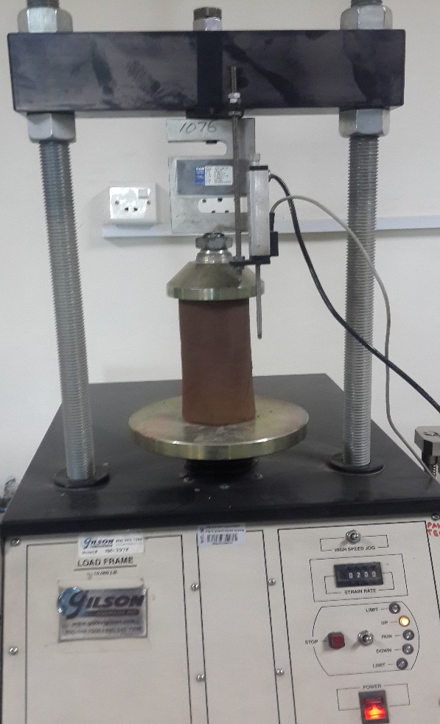
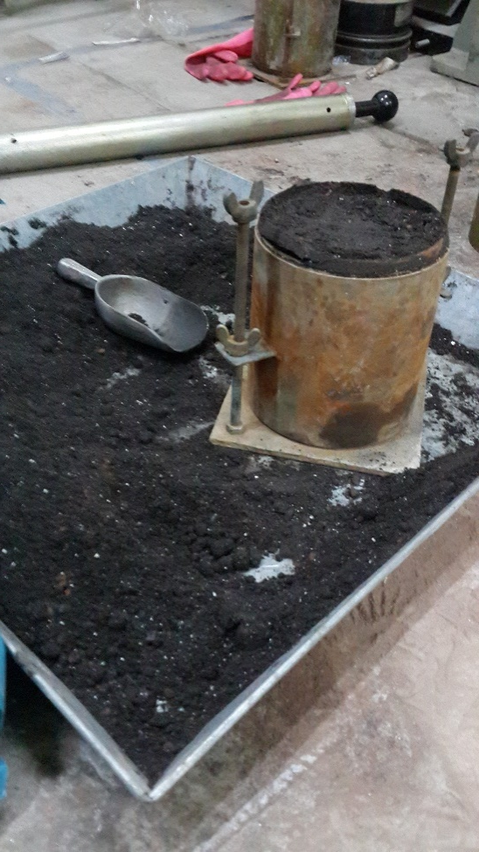
UCS and CBR
Unconfined compressive strength
  ASTM D 2166-00 (untreated)
  ASTM D 5102-09 (treated)
California bearing ratio
  AASHTO T 193-99 2003

Slide 17
Index | Mix design
S | Soil without additives
S + 3L | Soil + 3% Lime
S + 6L | Soil + 6% Lime
S + 3L + 5B | Soil + 3% Lime + 5% Bagasse ash
S + 3L + 10B | Soil + 3% Lime + 10% Bagasse ash
S + 3L + 15B | Soil + 3% Lime + 15% Bagasse ash
S + 3L + 20B | Soil + 3% Lime + 20% Bagasse ash
S + 6L + 5B | Soil + 6% Lime + 5% Bagasse ash
S + 6L + 10B | Soil + 6% Lime + 10% Bagasse ash
S + 6L + 15B | Soil + 6% Lime + 15% Bagasse ash
S + 6L + 20B | Soil + 6% Lime + 20% Bagasse ash

Slide 18
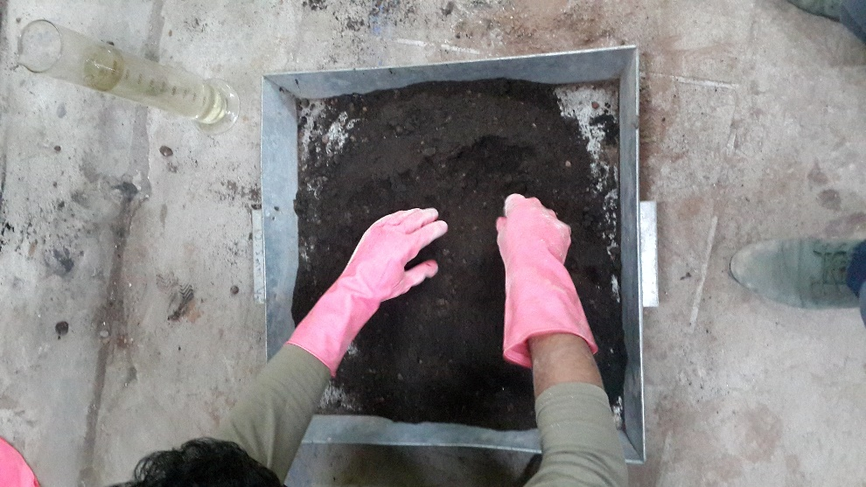
Fabrication of samples
Samples of treated soil were casted according to NLA (national lime association) mixture design and testing procedure 2006
Steps:
Soil-lime-ash mix after mixing and before fabricating was left for 1-2 hour for hydration

Slide 19
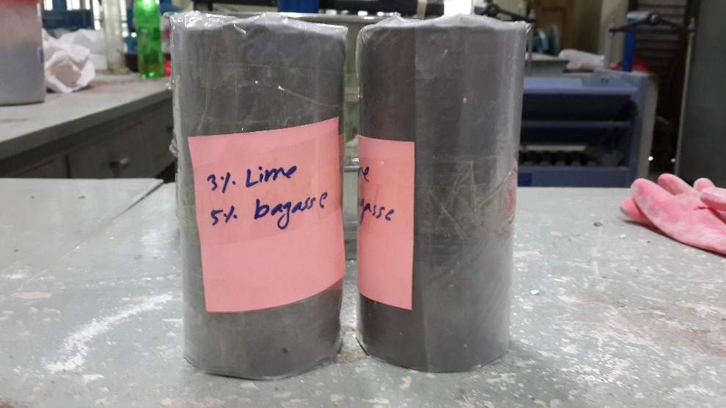
Fabrication of samples
After fabrication samples were packed in plastic sheet

Slide 20
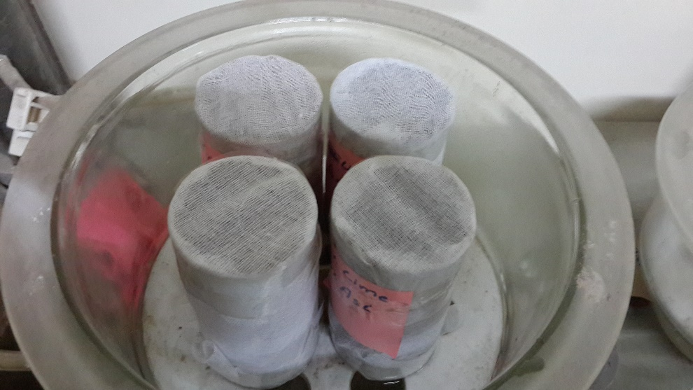
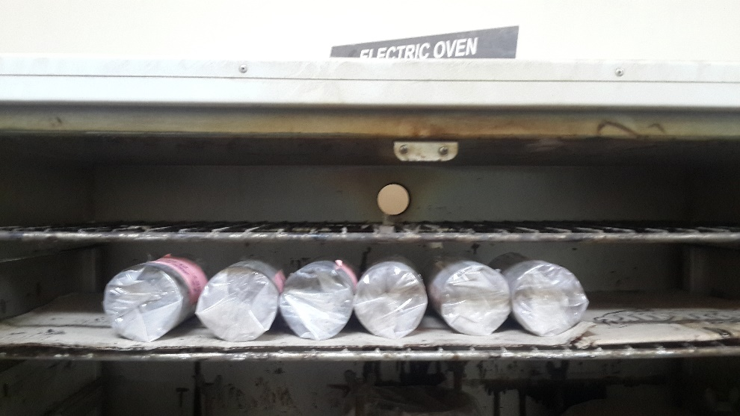
Soaking and curing
Samples of CBR and UCS were cured in oven for 7 days at 40C
UCS samples were soaked for 24hrs in desiccator
CBR samples were soaked for 96hrs

Slide 21
Characteristics of soil
Soil as per USCS |  | Silty
Soil as per AASHTO |  | A-4
Liquid limit (%) |  | 14
Percent Passing Sieve No. 200 |  | 26.6
Specific gravity |  | 2.91
Maximum Dry Density, (g/cm³) |  | 2.13
Optimum Moisture Content, (%) |  | 7.1
Unconfined Compressive Strength (UCS), (psi) | Unsoaked | 42
 | Soaked | 6.55
CBR, (%) | Unsoaked | 25
 | Soaked | 12
Swell, (%) |  | 2.1

Slide 22
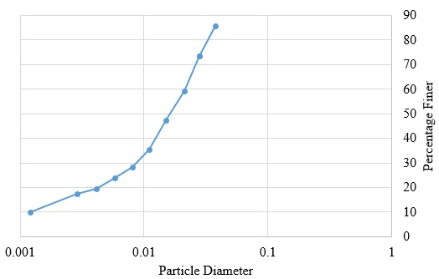
Test results and discussion
Hydrometric analysis curve

Slide 23
Test results and discussion
Chemical composition of Bagasse ash
Constituent | Percentage (%) | ASTM C 618 Requirement
Silicon Dioxide, (SiO₂) | 64.21 | Minimum 70%
Aluminium Oxide, (Al₂O₃) | 6.32
Ferric Oxide, (Fe₂O₃) | 4.94
Calcium Oxide, (CaO) | 7.10
Magnesium Oxide, (MgO) | 3.12
Sulfur Trioxide, (SO₃) | 0.83 | Maximum 4%
Sodium Oxide, (Na₂O) | 2.87
Potassium Oxide, (K₂O) | 4.79

Slide 24
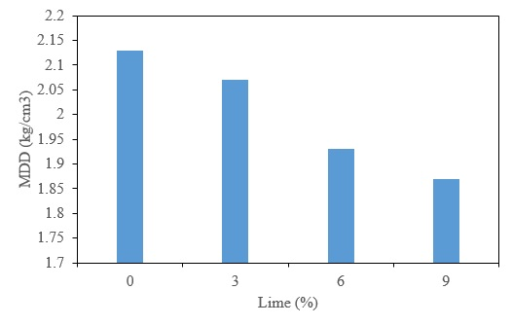
Test results and discussion
Maximum dry density of soil and soil-lime mixture

Slide 25
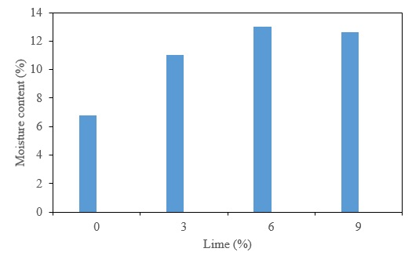
Test results and discussion
Optimum moisture content of soil and soil-lime mixtures

Slide 26
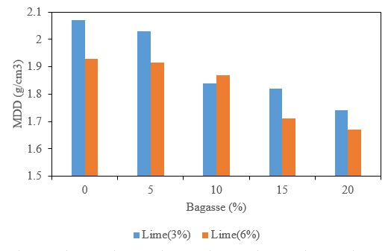
Test results and discussion
Maximum dry density at different soil-lime and soil-lime-bagasse ash mixtures

Slide 27
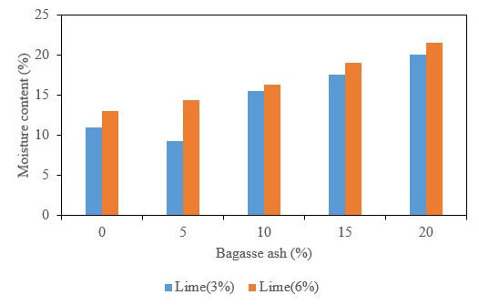
Test results and discussion
Optimum moisture content at different soil-lime and soil-lime-bagasse ash mixtures

Slide 28
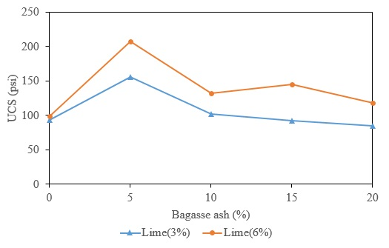
Test results and discussion
Unconfined compressive strength of soaked soil-lime and soil-lime-bagasse ash samples

Slide 29
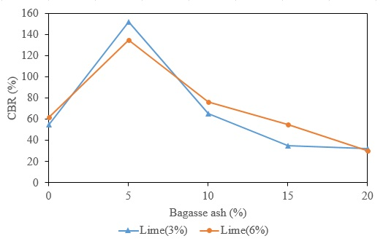
Test results and discussion
California bearing ratio CBR of soil-lime and soil-lime-bagasse samples

Slide 30
Conclusions
The soil is classified as silt as per UCSC and A-4 as per AASHTO
Unconfined compressive strength increases with addition of lime-bagasse ash
Optimum combination of lime and bagasse ash increase the CBR value
Swell potential reduces to zero with addition of lime and bagasse ash

Slide 31
Conclusions
3% to 6% lime with 0% to 5% bagasse ash is optimum
Addition of bagasse and lime reduce Maximum Dry Density and increase Optimum moisture content

Slide 32
The End
Thank you
Any Questions?

