Slide 1
Concept of library
Workshop Resource Person:
Muhammad Azhar Ishaq
MPhil LIS
MLIS(University of the Punjab)
Library Officer,
University of Veterinary and Animal Sciences , Jhang Campus .
Email :azharishaq27@gmail.com

Slide 2
Library
a place set apart to contain books, periodicals, and other material for reading, viewing, listening, study, or reference, as a room, set of rooms, or building where books may be read or borrowed.
a public body organizing and maintaining such an establishment.
a collection of manuscripts, publications, and other materials for reading, viewing, listening, study, or reference.
a collection of any materials for study and enjoyment, as films, musical recordings, or maps.
a commercial establishment lending books for a fixed charge; a lending library.
a series of books of similar character or alike in size, binding, etc., issued by a single publishing house.

Slide 3
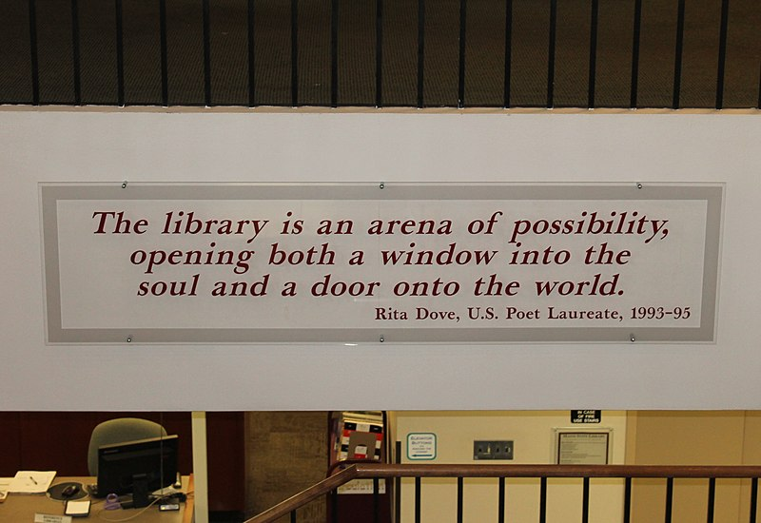

Slide 4
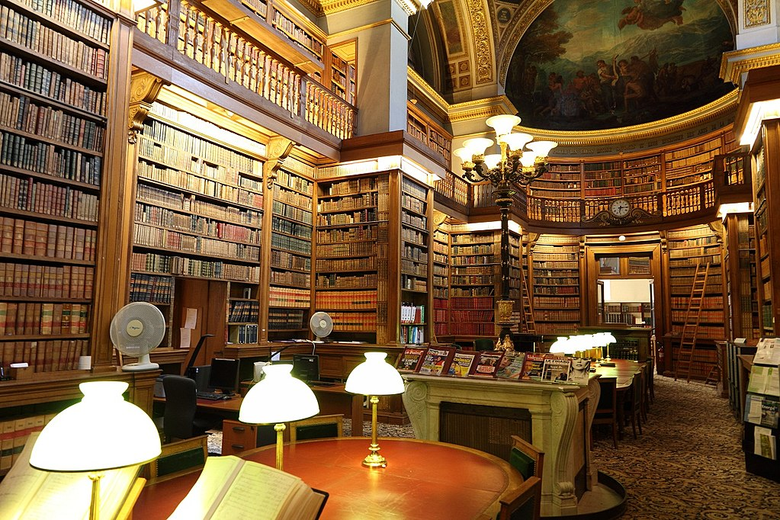

Slide 5
History
The earliest known library was discovered in Iraq and belonged to the ancient civilization in Sumer. They didn't use paper books but instead wrote everything on clay tablets using a style of writing called cuneiform. These tablets are over 5,000 years old. The Library of Alexandria, in Egypt, was the largest and most important library of the ancient world. It was destroyed when the Romans conquered Egypt in 30 BC. Rome’s first public library was established by Asinius Pollio who was a lieutenant of Julius Caesar. Eventually Rome would build 28 public libraries within the city. When the Roman Empire fell in 330 AD, many books went east to the city of Byzantium where a large library was built. Other libraries were built in monasteries and public homes.
Libraries began to appear in many Islamic cities, where science and philosophy survived after the fall of the Roman Empire. Christian monks and Islamic libraries exchanged books to copy.

Slide 6
Library
A library is a curated collection of sources of information and similar resources, selected by experts and made accessible to a defined community for reference or borrowing, often in a quiet environment conducive to study. It provides physical or digital access to material, and may be a physical location or a virtual space, or both.

Slide 7
What is a “Library”
The word "library" seems to be used in so many different aspects now, from the brick-and-mortar public library to the digital library. Public libraries—and indeed, all libraries--are changing and dynamic places where librarians help people find the best source of information whether it's a book, a web site, or database entry.
In The Librarian’s Book of Lists (Chicago: ALA, 2010), George Eberhart offers this definition:
"A library is a collection of resources in a variety of formats that is (1) organized by information professionals or other experts who (2) provide convenient physical, digital, bibliographic, or intellectual access and (3) offer targeted services and programs (4) with the mission of educating, informing, or entertaining a variety of audiences (5) and the goal of stimulating individual learning and advancing society as a whole."

Slide 8
Types of Library:
According to the mode of services rendered to the readers; libraries are broadly divided into four types:
1. Academic Library,
2. Special Library,
3. Public Library, and
4. National Library.

Slide 9
Academic Library
  1.Academic library is the library which is attached to academic institutions like schools, colleges and universities. An academic library serves more specifically the students, research scholars, teachers and staff of the academic institution. Main objective of an academic library is to give maximum learning materials to its clientele so that they may be fully educated in their respective level. Academic libraries are categorized into school libraries, college libraries and university libraries.

Slide 10
A. School Library:
  A school library is a learning laboratory, providing a variety of instructional media, essential for optimum support of the education programme. The purpose of the school library is to attain the objectives of the educational programme. It concerns with the development of effective methods of thinking, inculcation of social attitudes, acquisition of important information and promoting growth and development among the children. The function of the school library is to help the students in the process of their self-discovery, to adopt high ideals in life, improve scholastic efficiency through self-study and to develop the capacity for critical thinking.

Slide 11
B. College Library:
  College performs an important function in educational process. A college without a library is like a tree with no roots. The status of every college is measured through the position of the library that it maintains. Hence every college library should become a teaching instrument in itself. A college library is expected to support the objectives of the college. Thus, the basic function of a college library is to assist its parent body to carry out its programmes.

Slide 12
  C. University Library:
  A library is more important in a University, because a library can do without a University where as a university cannot function without a library. A university library is an integral part of the institution. It is primarily maintained for the benefit of students, officers, faculty members and for those who are engaged in research work. It plays a very important role in the national life of the community by acquiring material for educational use for the benefit of students and teaching departments.

Slide 13
  2. Special Library:
  Special library became popular since the beginning of 20th century. A special library is one which serves a particular group of people, such as the employees of a firm of government department, or the staff and members of a professional or research organization. Such a library deals essentially in information (Krishan Kumar; 1987; 72)

Slide 14
3. Public Library:
Public library (also called circulating library) is a library which is accessible by the public and is generally funded from public sources (such as tax money) and may be operated by the civil servants. Taxing bodies for public libraries may be at any level from local to national central government level. The public library is an excellent model of government at its best. A locally controlled public good, it serves every individual freely, in as much or as little depth as he or she wants. (Wikipedia)

Slide 15
  4. National Library:
  A national library is a library specifically established by the government of a country to serve as the preeminent repository of information for that country. Unlike public libraries, these rarely allow citizens to borrow books. Often, they include numerous rare, valuable, or significant works. A National Library is that library which has the duty of collecting and preserving the literature of the nation within and outside the country, Thus, National Library are those libraries whose community is the nation at large.

Slide 16
Children's libraries
Children's libraries are special collections of books intended for juvenile readers and usually kept in separate rooms of general public libraries. Some children's libraries have entire floors or wings dedicated to them in bigger libraries while smaller ones may have a separate room or area for children. They are an educational agency seeking to acquaint the young with the world's literature and to cultivate a love for reading. Their work supplements that of the public schools.

Slide 17
Reference libraries
A reference library does not lend books and other items; instead, they can only be read at the library itself. Typically, such libraries are used for research purposes, for example at a university. Some items at reference libraries may be historical and even unique. Many lending libraries contain a "reference section", which holds books, such as dictionaries, which are common reference books, and are therefore not lent out. Such reference sections may be referred to as "reading rooms", which may also include newspapers and periodicals.

Slide 18
Research libraries
A research library is a collection of materials on one or more subjects. A research library supports scholarly or scientific research and will generally include primary as well as secondary sources; it will maintain permanent collections and attempt to provide access to all necessary materials. A research library is most often an academic or national library, but a large special library may have a research library within its special field, and a very few of the largest public libraries also serve as research libraries

Slide 19
Digital libraries
Digital libraries are libraries that house digital resources. They are defined as an organization and not a service that provide access to digital works, have a preservation responsibility to provide future access to materials, and provides these items easily and affordably. The definition of a digital library implies that "a digital library uses a variety of software, networking technologies and standards to facilitate access to digital content and data to a designated user community." Access to digital libraries can be influenced by several factors, either individually or together.

Slide 20
A library is a great platform which helps us in various things. We get the reference material for our homework. Research scholars get reliable content for their papers. They increase our concentration levels as we read there in peace.

Slide 21
Librarians
A librarian is a person who works in a library. Librarians help people find books and information. They can teach people how to find books and use the library. A professional librarian is a person who went to school to study library science. They can earn a degree called a Masters in Library Science.

Slide 22
Why are libraries important
Libraries are important cornerstones of a healthy community. Libraries give people the opportunity to find jobs, explore medical research, experience new ideas, get lost in wonderful stories, while at the same time providing a sense of place for gathering.

Slide 23
Advantages offered by libraries:
In-Depth Research Resources not Available Elsewhere. ...
Curated and Quality Modern Collections. ...
Organized Tools and Resources. ...
Assistance and Help.

Slide 24
Advantages
Libraries often provide quiet areas for studying, and they also often offer common areas to facilitate group study and collaboration.
Libraries often provide public facilities for access to their electronic resources and the Internet.

Slide 25
Thank You

