Slide 1
Development of book
Workshop Resource Person:
Muhammad Azhar Ishaq
MPhil LIS
MLIS(University of the Punjab)
Library Officer,
University of Veterinary and Animal Sciences , Jhang Campus .
Email :azharishaq27@gmail.com
Mob: 0333-6701267

Slide 2


Slide 3


Slide 4
Book Development
Book Development is the condition for:
Having more books produced (output)
Producing different kinds of output to that which was previously produced
Changing the technical and institutional arrangements to produce and distribute this output
Having a book development council, in any country, plays a critical role in promoting and coordinating all areas of the book sector to ensure that they act in harmony with each other, as well as overall national development plans.

Slide 5


Slide 6
Steps to Writing Your Book
Create a plan. The first step to writing a book is to create a plan for how you will do so. ...
Plan the cover design. I usually hire a cover designer before I write the book. ...
Write. Once you have a plan, start writing. ...
3.1 Hire a ghostwriter. I prefer to write all my own content. ...
Read. ...
Edit. ...
Publish. ...
Launch.

Slide 7
Materials used to make a Book
A book is a medium for recording information in the form of writing or images, typically composed of many pages (made of papyrus, parchment, vellum, or paper) bound together and protected by a cover. The technical term for this physical arrangement is codex (plural, codices).

Slide 8
A book that knows why it is being written, for whom, and most important, what it wants to say, is a book well on its way to successful publication. ~ Susan Rabiner.
Its key purpose is to demonstrate that the book as an object, not just the text contained within it, is a conduit of interaction between readers and words.

Slide 9


Slide 10
Spoken books
The spoken book was originally created in the 1930s to provide the blind and visually impaired with a medium to enjoy books. In 1932 the American Foundation for the Blind created the first recordings of spoken books on vinyl records, In 1935, a British-based foundation, Royal National Institute for the Blind (RNIB), was the first to deliver talking books to the blind on vinyl records.

Slide 11
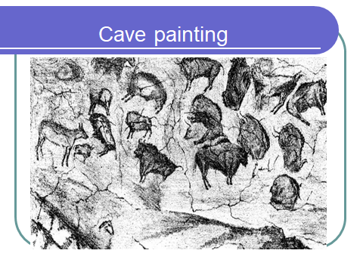

Slide 12
CLAY
Made of river mud
The tablets varied in shape (square, round and oblong) with rounded corners.
Usually the flat on top and slightly rounded on the bottom

Slide 13
Writing on Clay Tablets
The scribe used a thin pencil-like piece of wood cut diagonally on one end.
The stick was thrust into the wet clay where it formed wedge-shaped characters
Witting instrument was called a cuneus (wedge) and the characters cuneiform

Slide 14
Clay: Preservation
The tablets were then baked in the sun or kiln.
Clay book was comprised of a series of tablets.
In Nineveh, the capital of Babylonia 30,000 clay tablets were uncovered by archeologists.
20,000 clay tablets preserved in British Museum, London

Slide 15
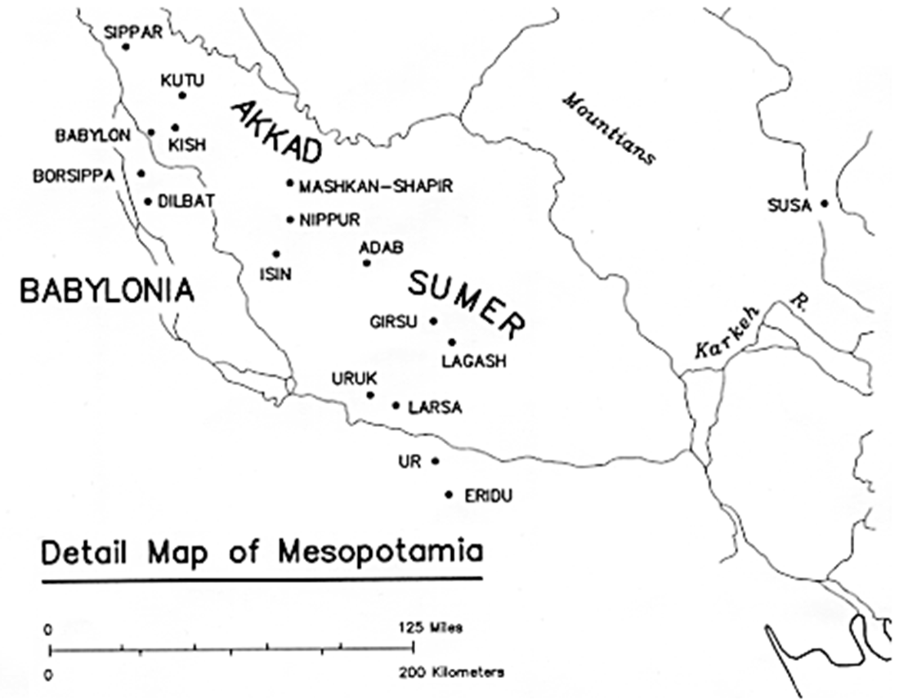
Map of Valley of Clay Tablets

Slide 16


Papyrus

Slide 17
Usage of Papyrus
Fuel
Making of rope
Cooked and juiced for food
Robes (loose outer garment)
Sandals
Rafts and Boats

Slide 18
The preparation of Papyrus
Papyrus cut and loaded in bundles into boat.
An inscription, dated 1475 BC, depicts the harvesting of the papyrus plant

Slide 19
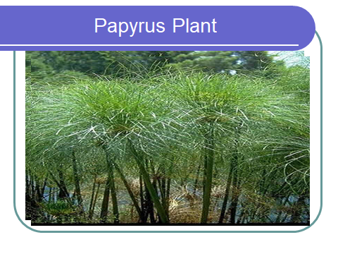

Slide 20
Five Rules of Textbook Development
The below list provides five rules that help guide the development of a good textbook.
1. Rule of frameworks
Memory and understanding are promoted by the use of a structure that mimics the structures we all use within our minds to store information. Before we can use or master a subject, we have to have a mental road map that allows us to navigate within and through the subject domain. The text can best aid understanding by making this framework visible early on within each section or topic.

Slide 21
2. Rule of meaningful names
Everything we know is tagged with an index or a title. These indices are critical to the ability to recall or retrieve the things we know and remember. Each concept, process, technique or fact presented should aid the student to assign a meaningful name for it in their own mental organization of the material. To be most useful, these names shouldn’t have to be relearned at higher levels of study. The names assigned by the text should be useful in that they support some future activities: communication with other practitioners, reference within the text to earlier mastered material, and conformity to the framework used for the subject.

Slide 22
3. Rule of manageable numbers
When we learn from an outline, an illustration, or an example, most of us are limited in our ability to absorb new material. As we become familiar with part of a subject domain this number expands, but for new material four to six new elements is a reasonable limit.

Slide 23
4. Rule of hierarchy
Our mental frameworks are hierarchical. Learning is aided by using the student’s ability to couple or link new material with that already mastered. When presenting new domains for hierarchical understanding, the rules for meaningful names and manageable numbers have increased importance and more limited application. A maximum of three levels of hierarchy should be presented at one time.

Slide 24
5. Rule of repetition
Most people learn by repetition, and only a few with native genius can achieve mastery without it. There is a pattern of repetition that aids in promoting the elements of a subject from short-term to long-term memory. Implementations of this rule may mean that frameworks and important hierarchies are repeated as many as five or six times, while frequently used elements are repeated three or four times, and elements of lesser utility may not be repeated at all.

Slide 25
Rules of Textbook Development long description:
The rule of frameworks means maintain a consistent structure. The text can best aid understanding by making this framework visible early on.
The rule of meaningful names means create and use consistent titles and terminologies. The names are critical to the ability to recall or retrieve the things we know and remember.
3 The rule of manageable numbers means limit the amount of new information introduced at one time.

Slide 26
Rule of hierarchy means new knowledge builds on learned knowledge. The student needs to understand the foundational knowledge before being introduced to a new concept. When new concepts are introduced the should be explicitly connected to the foundational material.
The rule of repetition means repeat important concepts. There is a pattern of repetition that aids in promoting the elements of a subject from short-term to long-term memory.

Slide 27
Thank You

