Slide 1
Library and information scienc
Asif BILAL
COURSE INSTRUCTOR

Slide 2
Unit 3
5501
RELATIONSHIP OF INFORMATION
SCIENCE
WITH LIBRARY SCIENCE

Slide 3
CONTENTS
Definition of information Science
Definition of Library Science
Beginning of Information Science
Primary history of library Science
Progress of Library Science as library and Information
Science
IS &LS Concerned task

Slide 4
CONTENTS
Relationship of IS with LS
Relationship of IS with LS according to S.R.
Ranganathan’s five laws.
Difference between IS & LS
Conclusion
References

Slide 5
DEFINITION OF INFORMATION SCIENCE
Information science is that discipline that investigates the properties and behavior of information, governing the flow of information, processing of information for accessibility and usability.
It primarily concerned with the analysis, collection, classification, manipulation, storage, retrieval, movement, dissemination, and protection of information.

Slide 6
DEFINITION OF INFORMATION SCIENCE
It is an interdisciplinary science derived from and related to such fields as mathematics, logic, linguistics, psychology, computer technology, operations research, the graphic arts, communications, library science, management, and other similar fields.

Slide 7
DEFINITION OF INFORMATION SCIENCE
The systematic study and analysis of the sources development collection, organization dissemination evaluation use, and management of information in all its forms, including the channels (formal and informal) and technology used in its communication. – –(Reitz, 2004)

Slide 8
DEFINITION OF LIBRARY SCIENCE
Collection of reading material, its processing, organization and dissemination started with the advent of library.
The knowledge and its implementation in respect of library may therefore be called library science.
The study of principles and practices of library care, and organization and administration of a library, and of its technical, informational, and reference services. (Harrods ‘Librarian’s Glossary)

Slide 9
DEFINITION OF LIBRARY SCIENCE
The professional knowledge and skill with which recorded information is selected, acquired, organized, stored, maintained, retrieved, and disseminated.
To meet the needs of a specific clientele, usually taught at a professional library school qualified to grant the postbaccalaureate degree of M.L.S. or M.L.I.S. The term is used synonymously in the United States with librarianship (Reitz,2004)

Slide 10
BEGINNING OF INFORMATION
It is difficult to place an exact date to the beginning of information science.
However, it is an old as man and civilization.
When the Garden of Eden, the first man and woman, Hazrat Adam (a.s) and Hazrat Eve (a.s) were created by the ALLAH SWT, and when order not to eat the fruit of the tree out of bounds, called the forbidden fruit, was violated.
One may cite that great fact may be called the first and foremost information.

Slide 11
PRIMARY HISTORY OF LIBRARY
From the pictographic, papyrus rolls, clay tablets and paper from information we have now moved to electronic era of 21st century.
It is during 20th century that a lot work of library development has taken place.
The clay tablet libraries, after covering a lot of distance, have now entered the age of electronic and virtual libraries.

Slide 12
PROGRESS OF L I BRARY SCI ENCE AS LIBRARY AND INFORMATION SCI ENCE
The first training program for librarians in the U.S. was established by Melvil Dewey in 1887.
It emerged as a separate field of study in the second half of the 19th century.
In the 20th century, library science was gradually subsumed under the more general field of information science.
Today's graduate programs in library and information science are accredited by the American Library Association (founded 1876) and prepare students for professional positions in other areas of the information industry

Slide 13
PROGRESS OF LIBRARY SCI ENCE AS LIBRARY AND INFORMATION SCI ENCE
Later, the term Library Science was used in the title of S. R. Ranganathan's The Five Laws of Library Science, published in 1931, and in the title of Lee Pierce Butler's 1933 book, an introduction to library science (University of Chicago Press).
The earliest formal use of the term information science dates back to 1958 when the institute of information scientists (IIS) was formed in the United Kingdom.
According to its founder, Jason Farradane, the use of the term information scientist,

Slide 14
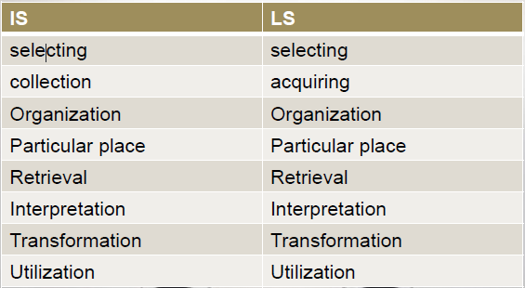
CONCERNED FUNCTION OF IS & LS

Slide 15
RELATIONSHIP OF IS WITH LS
The common ground between library science and information science, which is a strong one,
  is in the sharing of their social role and
  in their general concern with the problems of effective utilization of graphic records.
Different library experts have mentioned the similarities between library science and information science in their own way.
Here are their views

Slide 16
RELATIONSHIP OF IS WITH LS
Both fields emerged from the humanistic environment
Both fields are in transition
Both study human behavior in information exchange aiming at the creation of knowledge and ideas
Both approaches procure and handle information and apply new technology

Slide 17
RELATIONSHIP OF IS WITH LS
Both shares the same problems in designing and operating information systems;
Both are service oriented and changing fast
Information science is a part of library science, not a separate discipline; its claim to uniqueness has no empirical, philosophical, definitional or sociological evidence

Slide 18
RELATIONSHIP OF IS WITH LS
Information work is an extension of library work
Librarianship always provided services and at present has merely modified them by adding new hardware.
Hence there is a need to add word ‘information’ to the name of the domain ‘librarianship’

Slide 19
RELATIONSHIP OF IS WITH LS
Information science has both
  a pure science component, which inquiries into the subject,
  and applied science component, which develops services and products.
Librarianship and documentation are applied aspects of information science
Information science is branch of library science.

Slide 20
RELATIONSHIP OF IS WITH LS
Traditional librarianship (manual systems) is library science while modern librarianship (ICTs-based, etc.) is information
Library science is the foundation of information science except the development of computers (Rubin, 2000, p.20)
Concepts of information science are integrated with those of library science (Borko, as cited in Nitecki, 1995)

Slide 21
RELATIONSHIP OF IS WITH LS
Librarianship bridges the gap between information and its applications
Library science is concerned with the logistics and management of document.
Information Science is concerned with the content of these documents and the work tasks of users including problem solving and decision-making

Slide 22
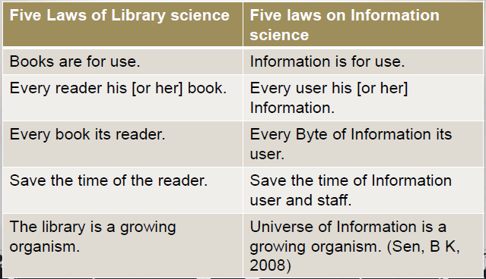
FIVE LAWS OF S.R. RANGANATHAN

Slide 23
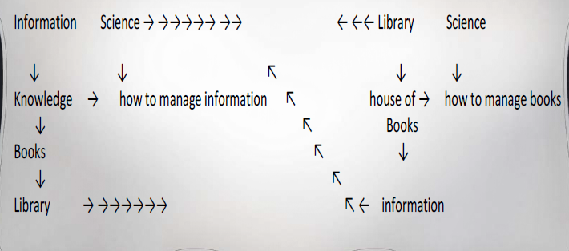
RELATIONSHIP OF IS WITH LS

Slide 24
DIFFERENCE BETWEEN INFORMATION SCIENCE & LIBRARY SCIENCE
Both have same objectives but differ in techniques used.
Information science is independent of any particular environment, while,
library science depends on parental institution or community.
Information science is not institution-based while, library science is nstitution/organization-based .

Slide 25
DIFFERENCE BETWEEN INFORMATION
SCIENCE &LIBRARY SCIENCE
The focus of information science is on the phenomenon of information.
Information science deals with the entire information cycle, from creation to use while
library science starts after the creation of information.

Slide 26
DIFFERENCE BETWEEN INFORMATION
SCIENCE &LIBRARY SCIENCE
Information science is an emerging field which is now a recognized discipline in an increasing number of major universities
Information science is an inquiry, and library science a service

Slide 27
DIFFERENCE BETWEEN INFORMATION
SCIENCE &LIBRARY SCIENCE
Information science investigates properties and behavior of information, its organization, storage, retrieval, interpretation, and utilization.
Library science concentrates on storing and disseminating knowledge contained in documents.

Slide 28
CONCLUSION
Both librarianship and information science have the information perspective in common.
Library science and information science have very different histories, and, in particular, different methodological and values perspectives, they have in common this core relationship to the material of their work.

Slide 29
Thank yOu

