Slide 1
Impact of perceived organizational support on employee JOB performance
Meenal Rashid Bajwa – MBA 2k13
Supervisor – Mr. Asad Amjad

Slide 2


INTRODUCTION

Slide 3
NEED OF THE STUDY
The growing trend of global human resource has significantly driven up the need for treating employees as the most predominant profit generating factor of organization with which it has now become important to study the behavioral factors which impact the employee productivity. More specifically in service based organizations employees are seen as the most significant asset for organizational success as service efficiency is mostly determined by the employee’s attitude towards their work and such a desirable attitude can only be developed through better formulation and implementation of human resource strategies and policies

Slide 4
VARIABLES | INTRODUCTION
Organization Culture | Organization culture is known as an organizational system that integrates its members through jointly shared values and rituals. It is the most precious thing a company has therefore it must have more exertion on it than anything else. POS tends to impact employee’s performance through its dimension of organization culture as it is the most apparent factor of any organization. Employees’ have greater capability of forming belief about all the actions directed towards them by the organization. At different level of organization culture different background, ethics and racial differences impact upon performance. The similar organization culture with different backgrounds has common set of values and beliefs to be effected by organization systems. (Robbins and Sanghi, 2007).
Motivation | Motivation at organizational level can be defined as a psychological driving force which induces the behavior of goal attainment in employees. . For example, achievement, accomplishment and competence are achieved from performing one’s job well. Extrinsic motivation comes from the working environment, not directly related to ones actual job. Fringe benefits and rewarding good actions are examples of this type of motivation
Commitment | Commitment to an organization can be referred to as an attachment of employees to their organization. The main area of concern is to find ways to improve how workers feel about their jobs. The regards of the employees toward the job tell about level of their commitment to the organization. Organizational commitment predicts the work including the job performance

Slide 5
VARIABLES | INTRODUCTION
TASK PERFORMANCE | It is the outcome of an individual. It has many dimensions i.e. behavioral, attitude, motivation, goal achievement, etc. It is the independent variable which can be assessed to reach the cause.

Slide 6
PROBLEM STATEMENT
The undergoing research aims to investigate the impact of Perceived Organization Support (POS) on the Job Performance of employees because of the significant increase in need for investigating the role of social relationships in the HR literature.

Slide 7
OBJECTIVE
To find out the importance of adopting organizational support behavior in the Telecom sector.
To find out the extent to which perceived organizational support affects job performance.
To determine the POC impact on Job Performance.
To make data analysis and interpretations based on the perception of employees and managers in organizations.

Slide 8
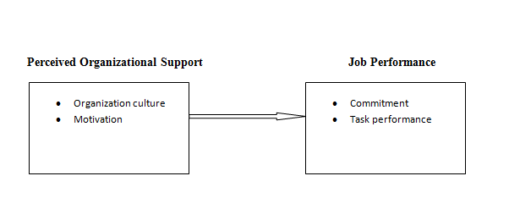
Theoretical Framework

Slide 9


Slide 10
LITERATURE
RELATIONSHIP | LITERATURE | FINDINGS
Organization Culture | (Robbins and Sanghi, 2007). (Denison,et al;2007). (Stewart, 2010). Awad and Saad (2013) Shahzad et al (2013)Wambugu (2014) | Various studies indicated that companies with strong cultures are more likely to be successful, stronger the culture means how widely and deeply its values are shared and respected by its employees. The norms of employees impact upon sustainable performance and management of organization culture as it leads to attainment of profitability
Motivation | Mankoe, 2006). (Katzell& Thompson, 1990). (Broni, 2012,Asim (2013) Edwin (1993). | Discussed extrinsic and intrinsic motivation. Motivation improves level of efficiency and helps achieve broader goals. Empirical showed rewards are most significant motivating factors
JOB PERFORMANCE | Bentzen (2009), Sturm (2009), Agnani and Aray (2009), Asteriou and Kavetsos (2006), Vetter and Wingender (1995) | Significant and effected by environmental factors. One powerful predictor to understand the cause of its negative or lower occurrence.

Slide 11
LITERATURE
RELATIONSHIP | LITERATURE | FINDINGS
Commitment | (Ismail,et al; 2011) (Alexandra, et al ;2010) Porter,et al: 1974) | Found that commitment is basically a will to align the goal of the individual with that of the organization. researchers found that commitment is a key for meeting the challenges.
Task Performance | Yau et al. 2012, Martins et al. (2010), Davis and Humphrey (2012a,b), Mikolajczak et al. (2007), Landa et al., (2008), Mayer and Salovey (1997) | The direct impact of Perceived Organizational Support (POS) and Perceived Supervisor Support (PSS) was seen on the task performance of employees.

Slide 12
Theoretical Framework

Slide 13
HYPOTHESIS STATMENTS
H1: Perceived Organizational support tends to affect the employees job performance positively and significantly
H1a: POS significantly and positively affect the employees’ level of commitment
H1b: POS significantly and positively affect the level of task performance
H2: Organizational Culture affects employee job performance positively and significantly
H2a: Organizational Culture affects employee commitment positively and significantly
H2b: Organizational Culture affects employee’s task performance positively and significantly
H3: Motivational Strategy affects employee job performance positively and significantly
H3a: Motivational Strategy affects employee commitment positively and significantly
H3b: Motivational Strategy affects employee’s task performance positively and significantly

Slide 14
DATA AND METHODOLOGY
Variable | Description
Unit of Analysis | Individual Level
Time Horizon | Cross sectional
Population and Sampling | Convenient Sampling technique Telecom Sector Islamabad, and Rawalpindi 100 responses returned
Instruments | Closed ended structured questionnaire used on a 5 point likert Scale The instrument developed for perceived organizational support includes two major measures that consist of organizational culture and motivational strategies. The instrument developed for perceived organizational support includes two major measures that consist of organizational culture and motivational strategies. The Questions on the dimensions of Job performance has been adapted by referring to the article of Linda K, et al (2013), whereas for the measurement of POS dimensions Eisenberger (1986) has been referred.

Slide 15
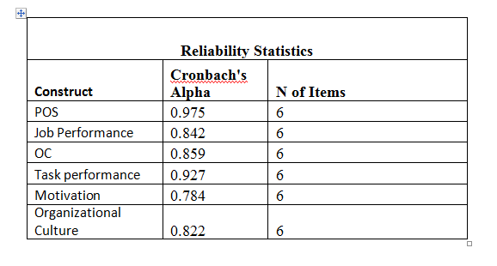
CHRONBACH ALPHA
The result usually consider as good or significant if the internal consistency of the measures are excellent. In this case reliability is highly significant with value of coefficient as good enough and desirable one
<0.6 Poor consistency >0.7 Suitable, >0.8 Excellent consistency

Slide 16
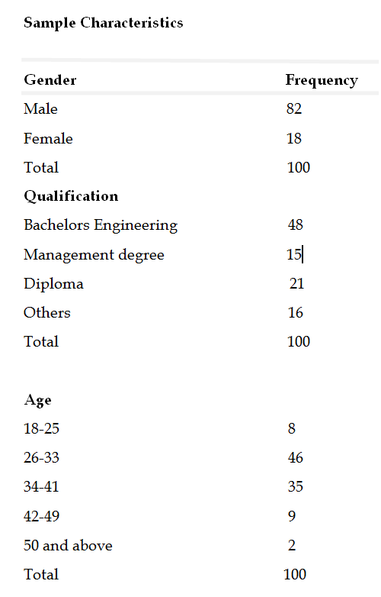
SAMPLE CHARACTERISTICS

Slide 17
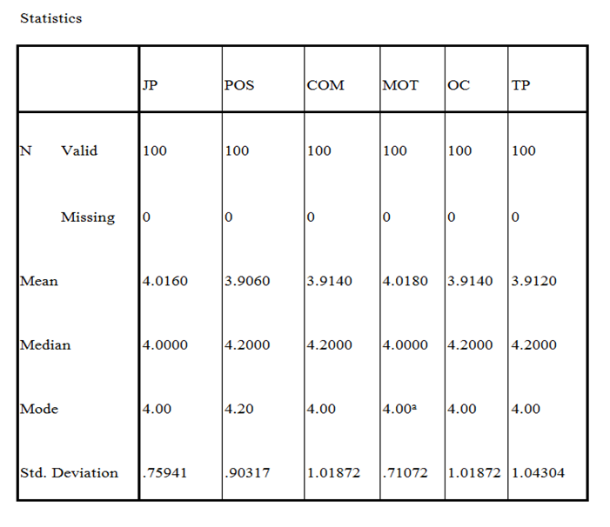
  Descriptive Statistics
The total no. of respondents in undergone research is 100. Descriptive analysis as depicted in table above shows that the mean value of variable Perceived Organizational Support is 3.90 with the standard deviation of .90317; it shows that an average with which the organization tend to impact Job performance of employees by adopting POS strategy is 390%.

Slide 18
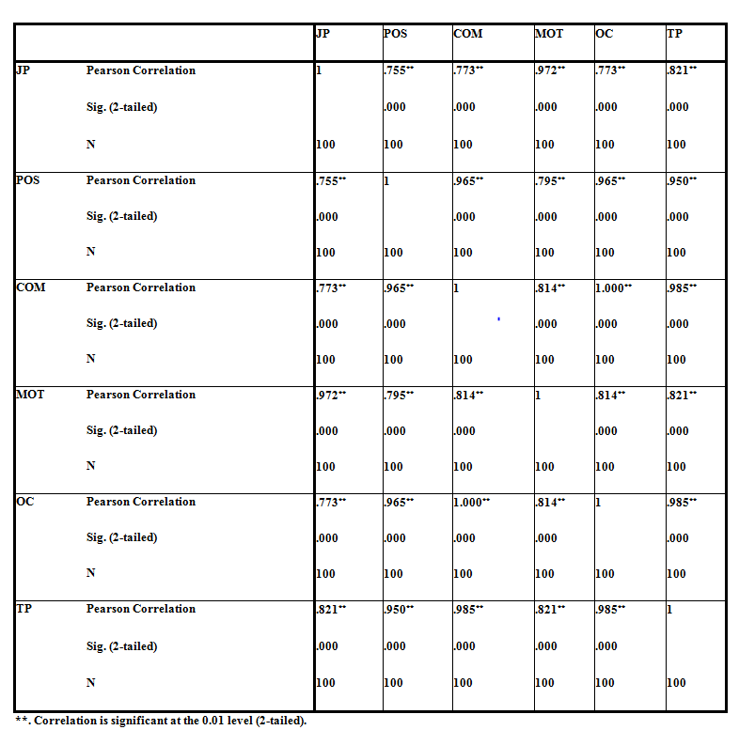
CORRELATION ANALYSIS
Pearson correlation coefficient value indicates the existence of positive and significant linear relationship among the variables of interest.

Slide 19
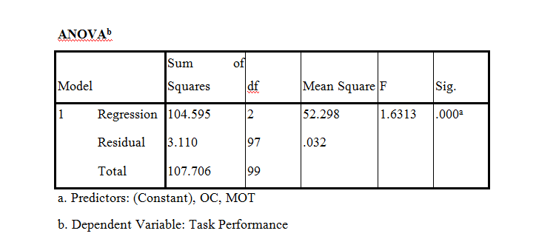
REGRESSION ANALYSIS
R is the squared root of R2 (R-square) and it depicts the correlation between observed and expected values of dependent variable on the other hand, R square indicates the amount of variance in dependent variable which can be explained or caused by an independent variables.
Model Summary^{b}
Model | R | R Square | Adjusted R Square | Std. Error of the Estimate | Durbin-Watson
1 | .865ª | .743 | .743 | .17907 | 1.904
a. Predictors: (Constant), OC, MOT
b. Dependent Variable: Task Performance

Slide 20
The value of Prob(F) is the probability that the null hypothesis for the full model is true (i.e., that all of the regression coefficients are zero). For example, if Prob(F) has a value of 0.01000 then there is 1 chance in 100 that all of the regression parameters are zero. This low a value would imply that at least some of the regression parameters are nonzero and that the regression equation does have some validity in fitting the data (i.e., the independent variables are not purely random with respect to the dependent variable).
The one-way analysis of variance (ANOVA) is used to determine whether there are any statistically significant differences between the means of three or more independent (unrelated) groups
An F statistic is a value you get when you run an ANOVA test or a regression analysis to find out if the means between two populations are significantly different.

Slide 21
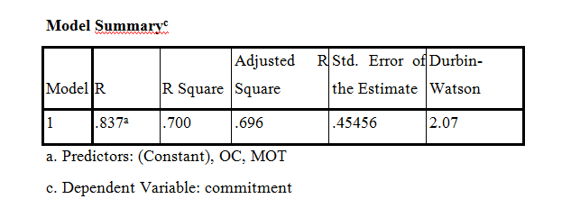
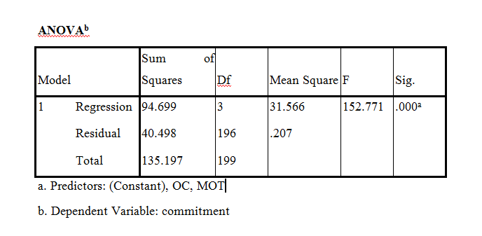
REGRESSION ANALYSIS

Slide 22
The Hypotheses for the Durbin Watson test are:
H₀ = no first order autocorrelation.
H₁ = first order correlation exists.
2 is no autocorrelation.
0 to <2 is positive autocorrelation (common in time series data).
>2 to 4 is negative autocorrelation (less common in time series data).

Slide 23
ANOVA
The one-way analysis of variance (ANOVA) is used to determine whether there are any statistically significant differences between the means of three or more independent (unrelated) groups
An F statistic is a value you get when you run an ANOVA test or a regression analysis to find out if the means between two populations are significantly different.

Slide 24
rESULTS
Over all the results are consistent with the influence of independent variable on the dependent variable with the effect of respective dimensions. Thus it is concluded that the relation proposed in the study has the meaning in the telecom sector of the Rawalpindi and Islamabad.
Correlation results explain that the all of the predictors have a strong positive relation with the dependent variable. POS has a strong positive relation with the job performance at the significance level of 0.000. Furthermore motivation and organizational culture also has a strong positive linear correlation at significance level 0.000 thus the results of undergone research conform the already stated relationships in theory.

Slide 25
LIMITATIONS
Time constraints were a major limitation in conducting the research. Longitudnal study would have been more effective
Sample size was small and restricted to Rawalpindi and Islamabad only.
All the variables are assessed through the questionnaire; this poses the common method of bias.

Slide 26
FUTURE DIRECTIONS
Future studies can:
It would be more effective if the team commitment and team performance is being measured relating to the team related outcome.
The managers can correlate the preferred outcomes to the aimed performance levels. They must ensure that the perception of the employees towards the organization is positive.
Organizations that work under the service sector should make sure the proper and efficient provision of quality support from organization to all the employees at all levels of organizations.

Slide 27
RECOMMENDATIONS
The same study could be conducted on a different industry or the different companies to see the organization support, commitment and performances of the employees.
It would be more effective if the team commitment and team performance is being measured relating to the team related outcome.
Work related attitudes should be given greater focus
It is beneficial to make substantial investment in such resources that helps in adapting and implementing organizational support activities.
Investing in training and development initiatives. Satisfied employees most tend to be great performers and achievers.
Organizations that work under the service sector should make sure the proper and efficient provision of quality support from organization to all the employees at all levels of organizations.

Slide 28


