Slide 1

Notes:
786

Slide 2

MATERIAL CLASSIFICATION USING ULTRASONIC ECHOES
By
Lt Cdr Abdul Rahman PN
Under the Supervision of
Cdr Dr Tariq Mairaj Rasool Khan PN
Notes:
I am Lt Cdr Abdul Rahman and for next 30 minutes or so I shall be endeavoring to brief this august gathering about my thesis on a duly deliberated subject i.e. MATERIAL CLASSIFICATION USING ULTRASONIC ECHOES. I am very grateful to Cdr Dr Tariq Mairaj Rasool Khan PN who has given me the opportunity to work under his able guidance for research on this topic.

Slide 3
GEC COMMITTEE
Cdr Dr Faisal Amir PN
Cdr Dr Sajid Saleem PN
Dr Muhammad Bilal Kadri
Notes:
I am also grateful to the respected GEC for sparing their valuable time for my support and guidance during the course of my thesis.

Slide 4
MOTIVATION
Notes:
Prior to the formal start of my presentation, I feel it necessary to make a mention of the factors which attracted me to carry out research on this topic.

Slide 5
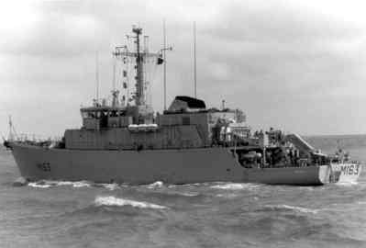
MOTIVATION
Notes:
My career in Pakistan Navy revolves around Mine Counter Measuring and Mine Hunting Vessel generally known as MCMVs. My responsibility onboard as weapon engineer officer was upkeep and maintenance of weapons and sensors used for mine hunting operations.

Slide 6
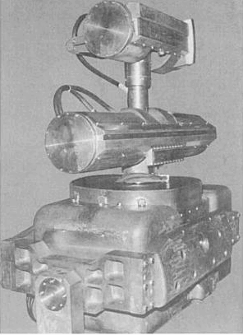
MOTIVATION
DET ARRAY
CLASS ARRAY
DUBM-21D
Notes:
DUBM-21D, the ultrasonic short range active sonar is an important element in mine hunting operations. This sonar has 2 separate arrays for detection and classification of mines during mine hunting operations. Both of these arrays operate on different ultrasonic frequencies, the detector array being on relatively lower frequency. The range of detector array is relatively longer than the classifier array. The pictorial understanding of a mine hunting operation is given on next slide.

Slide 7
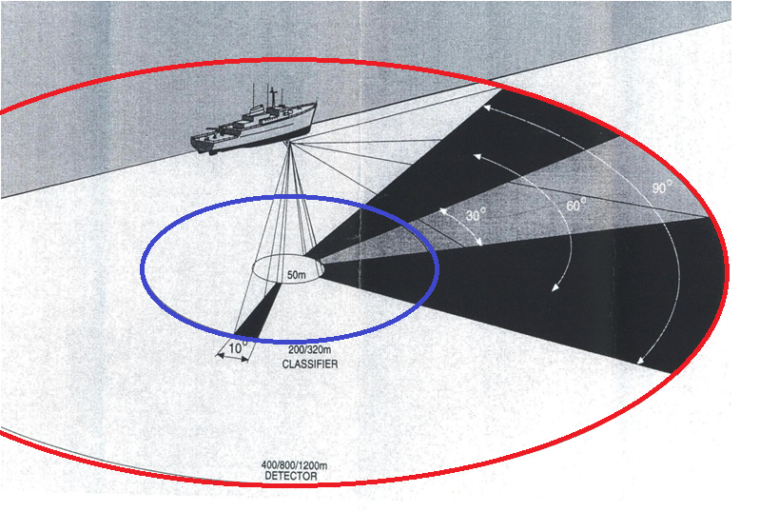
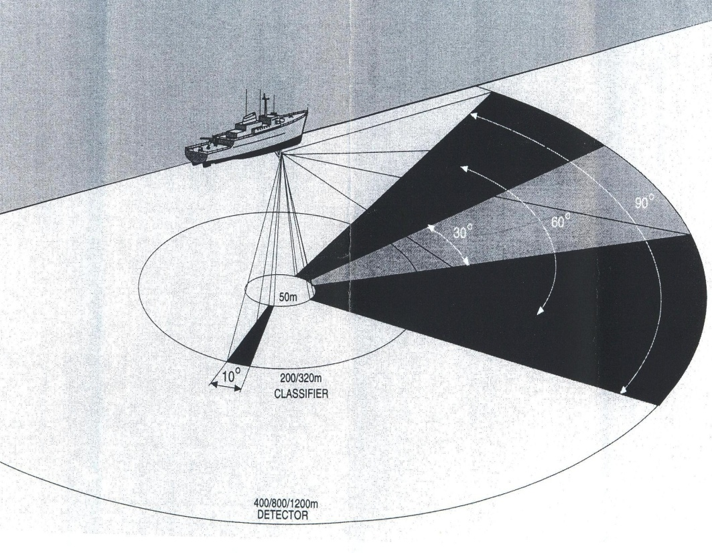
MOTIVATION
Detection Range
Classification Range
DET RANGE
DET RANGE
Notes:
In practical mine hunting operation, first of all a contact is picked on detector sonar display at relatively longer range, then the ship is moved very near to the contact to enable appearance of contact on classifier display. On this display, the primary classification of contact in mine like or not is carried out by human operator.

Slide 8
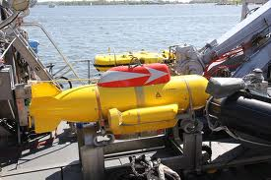
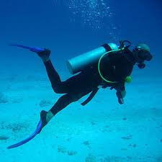
MOTIVATION
Risky operations
Notes:
The story does not end here rather if the contact is considered mine like then further evolutions of using PAP underwater vehicles and divers come into play for obtaining the positive identity of mine through visual aids. This in turn makes the mine hunting operation extremely dangerous as a slight error in any of the machinery onboard the MCMV can risk men or material.

Slide 9
MOTIVATION
Propose some way to make mine hunting operation less risky
Sonar itself will be able to classify the returning echoes from an underwater object in terms of its material i.e. metal or non-metal
Well outside the classification range of sonar thereby making the mine hunting operation less risky
Mine hunting operation will not be effected even if the classifier array is out of order
Notes:
This sonar do not possess any mean to classify the returning echoes w r t material of mine and only provide raw data about mine presence. This necessitates further evolutions of using PAP underwater vehicles or divers for positive identity of mines.

Slide 10
MOTIVATION
Two challenges
  Identification of expertise
  Acquisition of actual ultrasonic sonar data
Cdr Dr Tariq Mairaj PN is an NDT expert
Avenues including UW System Simulation Lab at WE School of PNS KARSAZ and MTC were contacted
MTC liked the idea of classification of sonar echoes
MTC team promised to provide data and interested in using the research results
Need and availability of expertise and data motivated to investigate efficacy
Notes:
This sonar do not possess any mean to classify the returning echoes w r t material of mine and only provide raw data about mine presence. This necessitates further evolutions of using PAP underwater vehicles or divers for positive identity of mines.

Slide 11
OUTLINE
Introduction
Literature Review
Objective
Scope
General Approach
    Acquisition of Data
    Feature Generation / Extraction
    Develop, Tabulate and Displays results
    Analysis
Conclusion
Future Work
Notes:
Coming to the outline of my presentation, I shall be briefly touching upon the subjects listed on the slide.

Slide 12
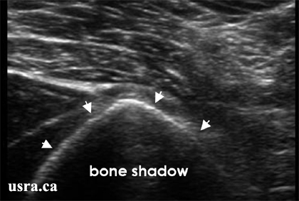
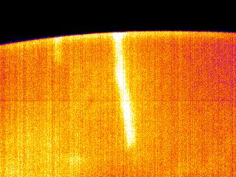
INTRODUCTION
Ultrasonic signals more than 20 Khz
Complex natured signals
Widely used in number of applications
  Medical field
  Non Destructive Testing (NDT)
  Naval domain onboard MCMVs
Notes:
Ultrasonic signals, as the name implies, are primarily the acoustic signal above the human hearing range i.e. more than 20 Khz. Despite being complex natured, ultrasonic signals are widely used in number of applications i.e. medical field commonly known as ultrasound and non destructive testing commonly known as NDT. Another application of ultrasonic signals is in naval domain wherein ultrasonic sonars are used onboard a mine hunting vessel commonly known as MCMV.

Slide 13
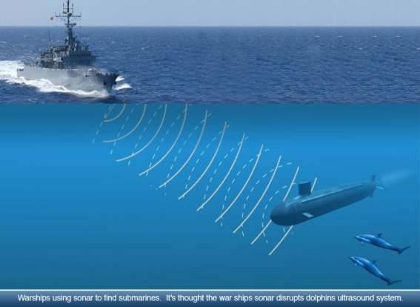
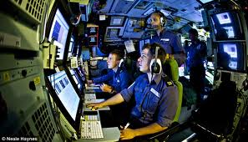
INTRODUCTION
Primary roles of sonar include discovery, location, tracking and categorization
Absence of classification of target restricts advanced utilization of sonar in naval warfare especially on MCMVs
MCMV sonar only provide raw data about mine
Notes:
Primary roles of a sonar system, onboard a naval unit, include discovery, location, tracking and categorization of underwater contacts through reception of acoustic signals. Here classification or recognition is a process of gathering information about objects in the environment and then to estimate their behavior. Despite the fact that confirmation for the presence of a target or object serves various purposes and makes sonar system a complete utility, the absence of any classification of target or object restricts the advanced utilization of sonar in naval warfare applications and compels the naval units to ensure various steps prior initiating any counter attack or maintaining track of specific vessel in presence of multiple vessels. This effect is even more pronounced when operating onboard a Mine Counter Measuring and Mine Hunting Vessel.

Slide 14
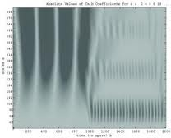
INTRODUCTION
Analysis of ultrasonic sonar signals is similar to sound recognition system above surface
Complex non stationary signals
Extremely sophisticated DSP and mitigation techniques
Notes:
The signal analysis of acquired ultrasonic sonar signals for identification and classification of mine is similar to sound recognition system above surface; upon which a good amount of work has already been done. The examples include speaker recognition systems, speech recognition systems, vehicle recognition systems and machine error, fault diagnosis or inspection systems. However, the basic difference in achieving the classification from ultrasonic sonar signals and above surface sound signals is the complexity involved in the signal processing. Though ultrasonic signals are quite informative and are extensively used in marine as well as NDT applications; however, they are reasonably complex due non stationary in nature and require sophisticated signal processing and modern classification techniques in order to derive useful information.

Slide 15
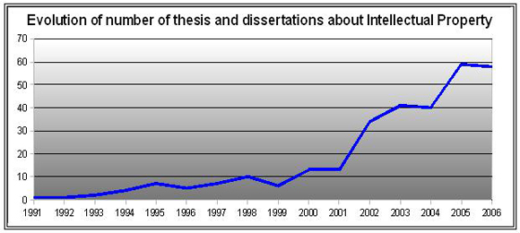
LITERATURE REVIEW
Availability of literature on the subject was very less primarily due to involved confidentiality
Some literature was reviewed which helped in establishing the significance of active sonar signal classification in mine warfare
Notes:
Prior deciding upon the objective and scope of the thesis, need was felt to review the literature available on the concept. The availability of literature on the subject was very less primarily due to involved confidentiality and nature of modern defence related commercial work. However, some literature was reviewed which helped in establishing the significance of active sonar signal classification in mine warfare. Let me say that literature review was the most time consuming activity of my thesis, however, today I feel that time spent on this activity has proved very much helpful towards completion of my thesis.

Slide 16
OBJECTIVE
To develop a suitable methodology to classify an ultrasonic active sonar signal and implement an acoustic analysis mechanism capable to classify the returning ultrasonic sonar echoes in terms of material of mine i.e. Metal or Non-Metal
Notes:
In the said backdrop the objective of this thesis is to develop a suitable methodology to classify an ultrasonic sonar signal and implement an acoustic analysis mechanism capable to classify the returning ultrasonic sonar echoes in terms of material of mine i.e. Metal or Non-Metal.

Slide 17
SCOPE
To classify the ultrasonic echoes from objects of different materials using advanced digital signal processing techniques.
Analysis of ultrasonic signal parameters/ characteristics vis-à-vis requirement of mine warfare
Notes:
According to the objective, the scope of this thesis was determined as shown on the slide. The same spells “To determine the differences in ultrasonic echoes from objects of different materials with the use of advanced digital signal processing techniques and to classify an underwater ultrasonic sonar signal through analysis of its parameters and characteristics while considering dynamics and complexities involved vis-à-vis requirement of mine warfare”.

Slide 18
GENRAL APPROACH
1
Acquisition of Data
2
Feature Generation / Extraction
Develop, Tabulate and Displays results
4
Analysis
3
Notes:
Based on the comparison of capabilities of the two basic types i.e. unsupervised and supervised learning methods, mentioned features and capabilities, supervised learning method is proposed for achieving the objective of this thesis. Supervise learning provides a systematic approach to achieve the desired material classification. The supervised learning methodology has four basic steps as shown on the slide. Each one will be discussed now in upcoming slides.

Slide 19
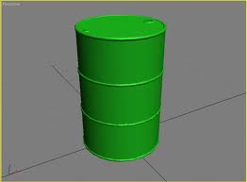
ACQUISITION OF DATA
    Ultrasonic signals generated by transmitter and reflected by objects were to be captured
    Actual signals acquired through an experimental setting
    Objects of metal and GRP were specially fabricated
Placement is well outside the classification range
Echoes from DET array captured through AD converter
1ST TIME IN PN
23 Inch
35 Inch
The basic dimensions of metal
and GRP objects
Notes:
Acquisition of data is the first step of Supervise learning methodology. However, irrespective of data type and nature of assignment, acquisition and collection of data is the most expensive and time consuming activity. Same is true in our case where ultrasonic signals generated from some ultrasonic transmitter and subsequently reflected by objects/mines having different materials were to be acquired.

Slide 20
FEATURE GENERATION/EXTRACTION
Core function – application of SP techniques to generate desired features for correct classification
Comprises of two phases:
    Pre-processing
    Application of Signal Processing Techniques
Notes:
The second step of supervise learning methodology is the application of selected signal processing techniques for generating the desired features. The core function of application of any signal processing technique is to generate the desired features for onward utilization in classification step. These features not only discriminate the recorded classes but play the most crucial rule in achieving a successful classification. The steps has a much wider and open option scope which starts after the acquisition of data and end till feature generation, just before the classification process. The two basic phases to accomplish the core task of this step are (a) Pre-processing of all trained and test signals and (b) Application of feature generation algorithms for selected features of particular domain.

Slide 21
    DATA PRE PROCESSING
    Sonar acquired signals contain unwanted noise
    Vary in nature and dynamic range
    Addressed through Pre-processing phase comprising of
        Windowing / Gating
        Digital Filtering
        Normalization
      Assists to improve the efficacy of classification process
Notes:
Since the acquired ultrasonic signal not only contained unwanted noise with them but also varied in their nature and dynamic range. These issues are handled through application of pre-processing phase. Though there is no fixed rule but in general, digital filtering, normalization and windowing processes are included in this phase. These processes filter out the unwanted noise associated with the signal under analysis, bring the signal into a range consistent with expected values, divide the signal into small sections for independent analysis and helps in removing the discontinuities and distortion. This phase not only improves the signal to noise but also enhances the accuracy and efficiency of the feature extraction processes. In short it assists to improve the efficacy of classification process.

Slide 22
    DATA PRE PROCESSING
Acquired ultrasonic signals were preprocessed prior features extraction process
Noise present was cancelled out by subjecting to ambient ultrasonic signals
Acquired ultrasonic signals were windowed
Notes:
In order to enhance the accuracy and efficiency of the extraction processes, the acquired ultrasonic signals were to be pre-processed before features extraction process. Accordingly, the noise present in acquired ultrasonic signals was cancelled out by subjecting them to ambient ultrasonic signals. Similarly the acquired ultrasonic signals were windowed, as explained in next slide.

Slide 23
    WINDOWING
Process of dividing the signal into small sections
Provides a snapshot of time varying signal for analysis
Must be taken into account:
  Short enough to represent the generating system to be stationary
  Must contain whole information of signal
Notes:
Windowing is the process of dividing the signal into small sections to be looked at independently from one another and helps in removing the discontinuities and distortion. Window function provides us a snapshot of time varying signal for analysis. Among the various methods of windowing e.g. multiply the signal by zero except at point of interest, choice of window involves tradeoff between several factors. However, two considerations must be taken into account for windowing i.e. it must be short enough to represent the generating system to be stationary and must contain whole information of signal or the selected fixed length must contains all the frequency components.

Slide 24
    WINDOWING
Calculations for computing the window of operation or Region of Interest were based on:
  Speed of Sound in water (v)
  Sampling Rate (Fs)
  Transmission Frequency (T_{f})
  Distance of Target from Transmitter (d)
  Time of Flight (T) and ROI have been calculated by:
  T = 2D/V
  and ROI = T x Fs
Notes:
The calculations for computing the window of operation or Region of Interest (ROI) were based on Speed of Sound in water, Sampling Rate, Transmission Frequency and approximate distance of Target from Transmitter. The Time of Flight and ROI have been calculated through the equations shown on the slide.

Slide 25
    APPLICATION OF SP TECHNIQUES
Ultrasonic signals are quite informative and are extensively utilized in marine and NDT applications
Reasonably complex due non stationary in nature
Require sophisticated signal processing and modern classification techniques to derive useful information
Notes:
Despite the fact that ultrasonic signals are quite informative and are extensively used in marine as well as NDT applications; they are reasonably complex due non stationary in nature, thus require sophisticated signal processing and modern classification techniques to derive useful information and subsequent feature generation. To process the acquired ultrasonic signals, available feature generation algorithms are mainly based on time, frequency and time-frequency domains. Each domain has its own merits and demerits. Selection of suitable domain and subsequent feature depends on the application and set objective. In our proposed methodology we will use sophisticated DSP techniques in all three domains.

Slide 26
    APPLICATION OF SP TECHNIQUES
Time Domain
Frequency Domain
Time-Frequency Domain
Each domain has own merits and demerits
Notes:
A crucial factor in having high classification accuracy is to develop signatures from the characteristic features that enable to differentiate among recorded signals. The objective of feature extractor therefore is to apply signal processing techniques to extract simple features, which are used to differentiate the diverse classes. Feature extraction or feature generation stage plays the most pivotal role in any classification process. Generally, linear transforms or algorithms are applied at this stage with maximum information filling properties to the input data which brought a small set of features encompassing all the class pertinent information. The criticality of this stage demands that required information remains intact during discarding or reducing redundant information. Loss of any required information will have direct influence on the subsequent stages of classification and will lead to error or false alarm. The existing algorithms for feature extraction are based on three domains: Time, Frequency and Time-Frequency domains. A short appraisal of these domains along with mathematical background will be discussed in next few slides.

Slide 27
    TIME DOMAIN
Time domain feature generation is the simplest domain
Suffers from environmental noise and affect the accuracy of classification
Variance, standard deviation, magnitude of signal, short time energy, zero crossing rate and percentage of low energy frames
Magnitude of signal was selected for ultrasonic signal classification due to low computational efforts and simple classification process
Notes:
First of all, the time domain. Among all feature generation algorithms, Time domain feature generation is the simplest domain. However, time domain features suffers from the environmental noise and affect the accuracy of classification. Whereas, presence of ambient noise in the medium and effect of reverberation with underwater acoustic signal, make the accurate classification of underwater signal more difficult as compare to classification of sound signal recorded in air. Variance, standard deviation, magnitude of signal, short time energy, zero crossing rate and percentage of low energy frames [5] etc are commonly used time domain features for classification. Among these possible options magnitude of signal was selected for ultrasonic signal classification due to the reasons that it required low computational efforts and simple classification process. It helps in simplest and direct extraction from input signal and produces adequate results.

Slide 28
    TIME DOMAIN
(a) Amplitudes of metal echoes
(b) Amplitudes of GRP echoes
Notes:
The next slide illustrates the time domain representation of ultrasonic echoes from both metal and GRP objects. The signal shown is a gated version of complete signal acquired and is truncated to an approximate time where the echo from the target is received for the first time. In time domain representation of data, though conspicuous and noticeable differences are registered in amplitudes of the signals from both the objects, however, these differences are not considered to be helpful in positive determination and identification of mine material. As no distinct discrimination is achieved using time domain, other signal processing techniques are investigated.

Slide 29
    FREQUENCY DOMAIN
Most commonly used method
Peaks detection, loudness and various spectral representations are extracted
Peak detection feature is selected
Acquired ultrasonic signals subjected to FFT
Algorithms work with the assumption of a stationary spectrum in a given time
Notes:
Frequency domain techniques are the most commonly used methods in classification processes for feature extraction. In frequency domain features like peaks detection, loudness i.e. energy and various spectral representations are commonly extracted. In the proposed methodology peak detection feature is selected for onward classification of ultrasonic signals through supervised learning process. In the proposed methodology both the acquired ultrasonic signals are subjected to Fast Fourier Transform (FFT) and only magnitude of each frequency component is selected through absolute function. Subsequently selected number of maximum amplitudes values were selected and stored with their positions. Frequency domain feature generation algorithms, work with the assumption of a stationary spectrum in a given time. The first step is the calculation of Fast Fourier Transform (FFT).

Slide 30

    FAST FOURIER TRANSFORM
FFT is a fast way of Discrete Fourier Transform
Changes the domain from time to frequency
Provides information for presence of frequency components
Information about the signal bandwidth and spectral energy distributions are accessible
Does not provide information of frequency contents over time scale
Unsuitable to explore non stationary signals
Computed through
Notes:
Fast Fourier Transform is a fast way of Discrete Fourier Transform and it changes the domain from time to frequency. Though FFT provide information for presence of frequency components in the signal, i.e. a few information about the signal bandwidth and spectral energy distribution are accessible. However, it doesn’t provide any information w.r.t. frequency contents of the signal over time scale. This issue makes the Fourier transform unsuitable to explore a signal with frequency contents that vary over time, i.e non stationary signals.

Slide 31
    FAST FOURIER TRANSFORM
(a) FFT of metal Target
(b) FFT of GRP Target
Notes:
Next slide illustrates the FFT of ultrasonic signals from metal and GRP objects respectively. The signals are again gated at the same length as was done in time domain signal processing. Different amplitudes at dominant frequencies are received from echoes acquired from GRP and metal. Therefore power spectral density of the gated acquired signals is also investigated.

Slide 32

    POWER SPECTRAL DENSITY
PSD describes distribution of power of signal
Power can be defined as the squared value of the signal
(a) PSD of metal Target
(b) PSD of GRP Target
Notes:
Power Spectral Density describes how the power of a signal or time series is distributed over different frequencies. Here, power can be the actual physical power, or more often, for convenience with abstract signals, can be defined as the squared value of the signal. The slide indicates Power Spectral Density of ultrasonic signals from both metal and GRP objects. Though the PSD calculations confirm the presence of additional frequency content in case of metallic object, however, the same does not offer significant discriminatory features. Therefore Time-Frequency techniques are tried.

Slide 33
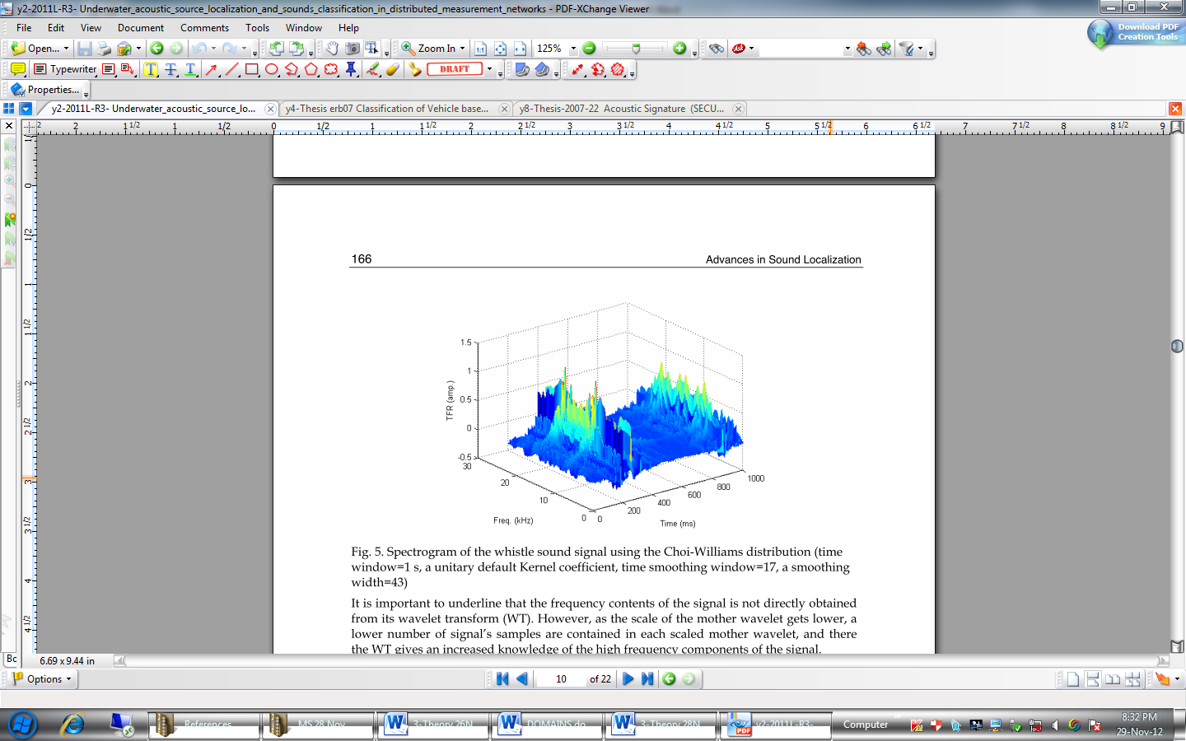
    TIME-FREQUENCY DOMAIN
Provide two dimensional functions of time and frequency
Short Time Fourier Transform (STFT)
Notes:
Although time and frequency domains provided some useful information about signal characteristics but lack due to their one-dimensional approach. On the other hand, Time-Frequency domain techniques provide two dimensional functions of time and frequency. In Time-frequency domain first is Short Time Fourier Transform.

Slide 34

    SHORT TIME FOURIER TRANSFORM
Introduced to resolve the issue related to non-stationary signals
Implements small frame sizes and reduces non-stationary signal behavior
Actually exploits the fact that signal it is stationary over a very short period of time
Represents signal energies, both in time and as well as in frequency domains
Computed through
Notes:
Under the time-frequency domain, Short Time Fourier Transform was introduced in 1946 to resolve the issue related to non-stationary signals pertaining to Frequency domain. Based on quantum mechanics, the physicist proposed STFT which implement small frame sizes and reduce the non-stationary signal behavior. Short Time Fourier Transform (STFT) is a classical case for implementation of the linear transform for feature extraction. STFT differs from FFT in terms that the signal in the STFT is manipulated with a sliding window function to get the chunks of the signal where it’s stationary. This means that it actually exploited the fact that though signal may not be completely stationary over complete time period but it is stationary over a very short period of time. Using STFT, frequency contents of a signal can be obtained over time scale. In other words STFT maps a signal into a two dimensional function of frequency and time.

Slide 35
    SHORT TIME FOURIER TRANSFORM
Maps signal into a two dimensional function of frequency and time
Provides a superior spectral power calculation
Very high computational complexity
Drawback of non-time resolution with the standard Fourier transform is resolved
There exists a compromise between time and frequency resolutions
Notes:
The outcome of STFT represents signal energies, both in time and as well as in frequency domains. It provides a superior spectral power calculation of the signal over time. However, time-frequency domain has a major drawback of very high computational complexity. Although, the drawback of non-time resolution with the standard Fourier transform is resolved. However, the main shortcoming associated with STFT is that it expressively depends on the parameters that are used for its evaluation or in other words there exists a compromise between time and frequency resolutions. The results of STFT computation of signal from metal and GRP are shown on next slide.

Slide 36
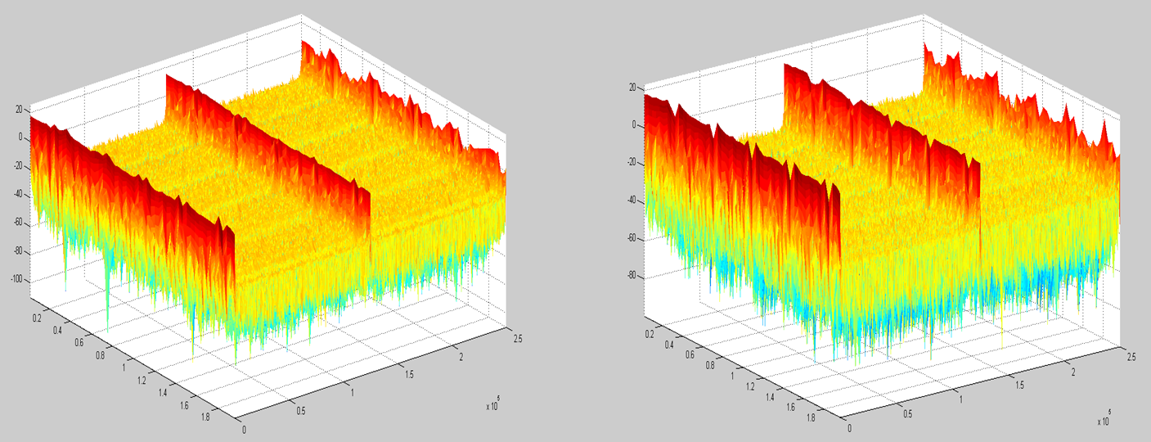
    SHORT TIME FOURIER TRANSFORM
Time
Hz
Time
Hz
(a) STFT of metal Target
(b) STFT of GRP Target
Notes:
It can be clearly seen that conspicuous differences are obtained at higher frequencies. During the STFT computations, the results obtained are the spectrogram and associated Power Spectral Density of both the objects. The same were calculated separately for the already gated signals in further smaller time intervals and the results obtained were tabulated for analysis purposes.

Slide 37
Slot No | Approx Distance meters | Spectrogram of Metal Object x 10⁵ |  | Spectrogram of GRP Object x 10⁵
 |  | Centre Frequency | Corner Frequency | Centre Frequency | Corner Frequency
1. | 100 | 2.8 | 1 | 3 | 0.5
2. | 214 | 2.5 | 2 | 1.9 | 1.2
3. | 328 | 3.1 | 0.8 | 3.1 | 0.5
4. | 332 | 2.8 | 1 | 2.8 | 0.8
5. | 556 | 2.9 | 1.7 | 2.5 | 2
6. | 670 | 2.8 | 1.2 | 3.1 | 0.5
7. | 784 | 2.8 | 2.2 | 3.2 | 1.2
8. | 898 | 2.5 | 1.2 | 2.6 | 1
9. | 1012 | 2.9 | 0.5 | 2.9 | 0.8
10. | 1126 | 2.9 | 1.6 | 3 | 1.4
11. | 1240 | 2.9 | 0.5 | 3 | 0.5
12. | 1354 | 4.8 | 1.4 | 3.4 | 3.4
13. | 1468 | 2.9 | 0.5 | 2.8 | 0.5
Notes:
The tables shown on next two slides give values of spectrograms and PSDs of metal and GRP objects in smaller time intervals.

Slide 38
Slot No | Approx Distance meters | Power Spectral Density of Metal Object |  | Power Spectral Density of GRP Object
 |  | Centre Frequency | Corner Frequency | Centre Frequency | Corner Frequency
1. | 100 | 40 | 15 | 45 | 15
2. | 214 | 30 | 20 | 20 | 15
3. | 328 | 50 | 15 | 50 | 15
4. | 332 | 40 | 15 | 40 | 15
5. | 556 | 40 | 20 | 30 | 20
6. | 670 | 35 | 15 | 50 | 15
7. | 784 | 40 | 30 | 55 | 15
8. | 898 | 30 | 15 | 35 | 15
9. | 1012 | 45 | 15 | 40 | 15
10. | 1126 | 45 | 20 | 45 | 15
11. | 1240 | 40 | 15 | 50 | 15
12. | 1354 | 115 | 15 | 60 | 50
13. | 1468 | 40 | 15 | 40 | 15
Notes:
As can be seen from these tables that at Slot No 12 highlighted in red i.e. the approximate time where returning echo of the targets is received, the calculated spectrogram and PSD of received signal change abruptly for metals and GRP signals.

Slide 39
    SHORT TIME FOURIER TRANSFORM
(a) PSD of metal and GRP Targets
(b) Spectrogram of metal and GRP Targets
Notes:
The confirmation for these abrupt changes in computed spectrograms was obtained by computing the differences of spectrogram between both the signals. The difference between the spectrograms of metal and GRP as shown on the slide. The eclipse in the figure indicates the time where maximum difference between the spectrograms of metal and GRP targets is registered. This maximum difference in spectrograms of both objects appears at the approximate time where returning echoes from the objects are received.

Slide 40
    SHORT TIME FOURIER TRANSFORM
Difference between Spectrograms of metal and GRP signals
Notes:
The confirmation for these abrupt changes in computed spectrograms was obtained by computing the differences of spectrogram between both the signals. The difference between the spectrograms of metal and GRP as shown on the slide. The ellipse in the figure indicates the time where maximum difference between the spectrograms of metal and GRP targets is registered. This maximum difference in spectrograms of both objects appears at the approximate time where returning echoes from the objects are received.

Slide 41
ANALYSIS OF RESULTS
Both objects are of different materials
Acoustic impedances are different
Acoustic impedance of metal = 46.4 rayls/m² and Acoustic impedance of GRP = 13 rayls/m²
Difference in acoustic impedances resulted in different PSDs and Spectrograms
Sound transmission takes place under the influence of sound pressure
Acoustic impedance of a material is defined as the product of its density and acoustic velocity
Important in accessing acoustic transmission and reflection at the boundary of two materials
Notes:
The analysis of the results obtained from STFT computations revealed that as both the objects are of different materials, therefore, their target strengths and associated acoustic impedances are also different. Acoustic impedance for metal is 46.4 rayls/m² and for GRP 13 rayls/m². The difference in target strength and associated acoustic impedances of both the objects result in different PSDs and spectrograms. The theoretical aspects of this assumption narrates that sound transmission through materials takes place under the influence of sound pressure. As the molecules or atoms of a material are bound elastically to one another, the excess pressure results in a wave propagating through the material. The acoustic impedance of a material is defined as the product of its density and acoustic velocity. Acoustic impedance is important in accessing acoustic transmission and reflection at the boundary of two materials having different acoustic impedances, the design of ultrasonic transducers and the absorption of sound in a medium.

Slide 42
ANALYSIS OF RESULTS
(a) PSD of metal and GRP Targets
(b) Spectrogram of metal and GRP Targets
Notes:
During the course of analysis on acoustic impedance, an interesting feature for shift in frequency was noticed as shown on the slide. This shift in frequency was prominent at Slot 12 i.e. the reception time of object echoes. On further study, it was revealed that this shift in frequency of target echoes is a well known phenomenon experienced in transmission and reception of ultrasonic frequencies and is widely used in NDT applications. This phenomenon is commonly known as Mode Conversion. Accordingly, this unique feature was further studied which revealed.

Slide 43
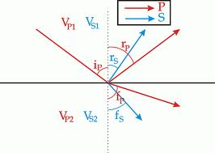
MODE CONVERSION
Transformation of energy takes place, when sound passes through a solid material
Happens when a wave encounters an interface between materials of different acoustic impedances
Ultrasonic signals can become confusing
Notes:
Transformation of energy from one form to another takes place, when sound passes through a solid material. For example, when a longitudinal wave hits an interface at an angle, some of the energy can cause particle movement in the transverse direction to start a shear (transverse) wave. Mode conversion happens when a wave encounters an interface between materials of different acoustic impedances and the incident angle is not normal to the interface. It can be seen that since mode conversion occurs every time a wave hits an interface at an angle, ultrasonic signals can become confusing at times.

Slide 44
MODE CONVERSION
Refraction takes place at the interface
Larger difference in acoustic velocities between the two materials causes more refraction
When ultrasonic frequencies of sonar strike the objects with different acoustic impedances, the amount of refraction produced is also different
Net effect obtained is the appearances of refracted frequencies
Notes:
When sound waves pass through an interface between materials having different acoustic impedances, refraction takes place at the interface. The larger difference in acoustic velocities between the two materials causes more refraction in sound. Similarly, when ultrasonic frequencies of sonar strike the objects with different acoustic impedances, the amount of refraction produced is also different. The role of shear waves and longitudinal wave also comes into play for this uneven refraction at that time but the net effect obtained is the appearances of frequencies at refracted places.

Slide 45
MODE CONVERSION
Refraction of sound waves depend on size, shape and acoustic impedance of the target
Acoustic impedances of metal, GRP and water are 46.4, 13 and 1.572 rayls/m² respectively
Difference between acoustic impedances of seawater and metal and between acoustic impedances of seawater and GRP are different
Net refraction from both these objects would also be different
Notes:
The refraction of sound waves at a target, whose dimensions are large compared with the acoustic wavelength, depends on its size and shape as well as the acoustic impedance of the target relative to that of water. The acoustic impedances of metal and GRP are 46.4 and 13 rayls/m² respectively, whereas the acoustic impedance of seawater is 1.572 rayls/m². As the difference between acoustic impedances of seawater and metal and between acoustic impedances of seawater and GRP are different, the net refraction from both these objects would also be different

Slide 46
    SHORT TIME FOURIER TRANSFORM
(a) PSD of metal and GRP Targets
(b) Spectrogram of metal and GRP Targets
Notes:
The confirmation for these abrupt changes in computed spectrograms was obtained by computing the differences of spectrogram between both the signals. The difference between the spectrograms of metal and GRP as shown on the slide. The eclipse in the figure indicates the time where maximum difference between the spectrograms of metal and GRP targets is registered. This maximum difference in spectrograms of both objects appears at the approximate time where returning echoes from the objects are received.

Slide 47
ANALYSIS OF RESULTS
Application of modern and sophisticated time-frequency signal processing techniques yield positive results wherein an important phenomena of mode conversion is registered
Computation of this unique feature of ultrasonic signals from objects of different materials and associated acoustic impedances has the capability and potential to be used as discriminatory feature between underwater objects
Notes:
On the basis of analysis of STFT, acoustic impedance and mode conversion phenomenon as explained in previous slides, it can be summarized that application of modern and sophisticated time-frequency signal processing techniques on ultrasonic signals yields positive results wherein an important phenomena of mode conversion is registered. The computation of this unique feature of ultrasonic signals reflected back from objects of different materials has the capability and potential to be used as discriminatory feature between underwater objects.

Slide 48
CONCLUSION
Efforts were made to study the usability of modern signal processing techniques for classification of ultrasonic signals
A reasonable set of ultrasonic signals was acquired and used in testing of proposed methodology and achieving of reliable results
All three domains i.e. time, frequency and time-frequency domains were used for features extraction
Practical implementation reveals that selected features of Time-Frequency domain are capable to classify the ultrasonic echoes w.r.t. material
Notes:
In order to achieve its set objective of this thesis i.e. classification of ultrasonic echoes w.r.t. mine material, efforts were made to study the usability of modern signal processing techniques for classification of ultrasonic signals. Despite limitations of high cost and military confidentiality, a reasonable set of ultrasonic signals was acquired and used in testing of proposed methodology and achieving of reliable results. In the proposed methodology all three domains i.e. time, frequency and time-frequency domains were used for features extraction. The practical implementation reveals that selected features of Time-Frequency domain are capable to classify the ultrasonic echoes w.r.t. material, from which they are reflected back, to a reasonable extent and considered quite suitable for the purpose.

Slide 49
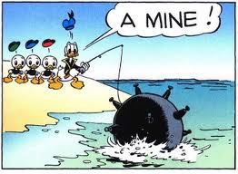
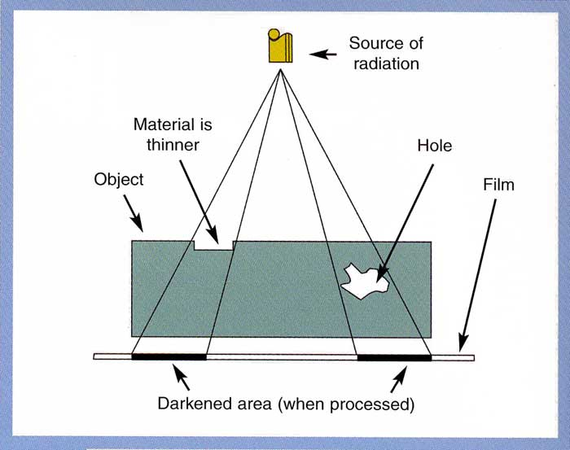
APPLICATION
Application in maritime domain
Useful in ultrasonic NDT
Enable the sonar operators to classify the underwater objects
Helpful in threat perception and application of counter measures
Results will be discussed with MTC
Notes:
This research has primarily been selected for application in maritime domain; however, it can also be applied in many other fields such as ultrasonic NDT. The use of this technique in maritime domain would enable the sonar operators to classify the underwater objects in terms of their material well outside the classification range of ultrasonic sonar onboard a mine hunting vessel with use of only the detector sonar. The same would be helpful in decision making about the threat perception and subsequent application of suitable counter measures. Similarly, the ultrasonic NDT techniques would be helpful in ship / submarine construction as well as maintenance departments.
It is worth mentioning that despite being a confidential subject, the findings of my thesis were transformed into a paper. Naval intelligence was approached to obtain clearance and on accord of that a paper has been submitted for publication in IEEE Transactions on Radar, Sonar and Navigation. The paper is currently under review.

Slide 50
FUTURE WORK
Conspicuous results show that time-frequency domain based technique has a potential to discriminate the ultrasonic signals
Potential will be exploited through variety of other modern signal processing and classification techniques i.e. Wavelet Transform, Hilbert Huang Transform (HHT) and Empirical Mode Decomposition (EMD)
Work on wavelet transform and EMD has already been initiated and has shown positive results on initial computations
Notes:
The conspicuous results from the above stated work are testimony of the fact that the time frequency domain based technique has a potential to discriminate the signals in the subject study. This potential will be exploited through variety of other modern signal processing and classification techniques i.e Wavelet Transform, Hilbert Huang Transform (HHT) and Empirical Mode Decomposition (EMD).
As a matter of fact, work on wavelet transform and EMD has already been initiated and has shown positive results on initial computations as shown on next two slides. The further analysis of wavelet and EMD could not be undertaken due shortage of time and my transfer to Islamabad.

Slide 51
FUTURE WORK
Wavelet Transform of Metal Object
Wavelet Transform of GRP Object

Slide 52
FUTURE WORK

Slide 53
Q & A
  Despite confidential subject, contents of thesis transformed into paper
  Clearance from Naval Intelligence was obtained
  Paper has been submitted for publication in IEEE Transactions on Radar, Sonar and Navigation

Slide 54
LITERATURE REVIEW
Octavian Adrian Postolache, José Miguel Pereira and Pedro Silva Girão, “Underwater Acoustic Source Localization and Sounds Classification in Distributed Measurement Networks”, Instituto de Telecomunicações, ESTSetúbal/IPS (LabIM)
David Roberts, “Voice Recognition Using MATLAB”, Version 1.4: Jun 2010, URL: http://cnx.org/content/m33347/1.4
Mangesh S. Deshpande and Raghunath S. Holambe, “Speaker Identiﬁcation Using Admissible Wavelet Packet Based Decomposition”, International Journal of Information and Communication Engineering 6:1, 2010
Ahmad Aljaafreh and Liang Dong, “An Evaluation of Feature Extraction Methods for Vehicle Classiﬁcation Based On Acoustic Signals”, 978-1-4244-6452-4/10, IEEE 2010
Helen H. Ou, Whitlow W. L. Au and Vassilis L. Syrmos, Underwater Ordnance Classiﬁcation Using Time-Frequency Signatures of Backscattering SignalsSamples. 978-1-4244-4333-8/10/$25.00 ©2010 IEEE
Kil Woo Chung, Alexander Sutin, Alexander Sedunov, and Michael Bruno, “ DEMON Acoustic Ship Signature Measurements in an Urban Harbor”, Advances in Acoustics and Vibration Volume 2011 (2011), Article ID 952798, 13 pages, doi:10.1155/2011/952798

Slide 55
LITERATURE REVIEW
Saad Khan, Ajay Divakaran, and Harpreet S. Sawhney, “Weapon identification across varying acoustic conditions using an exemplar embedding approach”, Proc. SPIE 7666, 76662B 2010); http://dx.doi.org/10.1117/12.850185. [last accessed on 12 Feb 2013]
E. Darren Ellis, “Design of a Speaker Recognition Code using MATLAB”, Department of Computer and Electrical Engineering – University of Tennessee, Knoxville, 2001.
Project Report “Speaker Recognition”, available at: http://speaker-recognition.googlecode.com/files/Finally_version1.pdf [last accessed on 13 Feb 2013].
Allam Mousa, “Mare Text Independent Speaker Identification based on K-mean Algorithm”, International Journal on Electrical Engineering and Informatics ‐ Volume 3, Number 1, 2011
Li Liu, Ground Vehicle Acoustic Signal Processing Based on Biological Hearing

Slide 56
LITERATURE REVIEW
Models. MS Thesis, Dept. of Electr. Eng.,University of Maryland, College Park, Maryland, 1989.
Amir Averbuch, Eyal Hulata, Valery Zheludev and Inna Kozlov, “A Wavelet Packet Algorithm for Classiﬁcation and Detection of Moving Vehicles”. Multidimensional Systems and Signal Processing, 12, 9–31 (2001)
Baofeng Guo, Mark. S. Nixon and Thyagaraju Damarla, “Acoustic Information Fusion for Ground Vehicle Classiﬁcation”. 11th International Conference on Information Fusion, Cologne, Germany, 2008. ACITA 2008, Page 190
http://www.ndt- ed.org/EducationResources/CommunityCollege/Ultrasonics/Physics/modeconversion.html
W. Zhu , J. L. Rose , J. N. Barshinger & V. S. Agarwala (1998) Ultrasonic Guided Wave NDT for Hidden Corrosion Detection, Research in Nondestructive Evaluation, 10:4, 205-225
Nondestructive Testing Handbook 3rd Edition by Patrick O Moore.

Slide 60
    APPLICATION OF SP TECHNIQUES
  Core issue of application of feature generation algorithms
    Each domain has its own feature and dedicated technique for feature extraction
    Each domain has its own capabilities and limitations
    Feature extraction is applied to all domains independently
    Outcome forms the feature vector space for onward utilization
Notes:
This phase is the core issue of the application of signal processing techniques. As explained earlier, all types of acoustic and ultrasonic signals contain various features in different domains which can be extracted through application of suitable algorithms for their classification. The outcome of this phase forms the feature vector space which will be utilized in selected classifier for accomplishing the classification of ultrasonic test signal. Each domain has its own capabilities and limitations. Therefore selection of suitable domain and respective suitable feature depends on the objective/application and comparative assessment of their classification results.

Slide 61
    FORMULATION OF THE APPROACH/METHODOLOGY
ACQUISITION OF ULTRASONIC SIGNALS
DATA PRE-PROCESSING
FEATURE GENERATION & CLASSIFICATION
TIME DOMAIN
FREQ DOMAIN
TIME-FREQ DOMAIN
RESULT ANALYSIS
Notes:
With the decision of using supervise learning and developing clear understanding of its phases, the next step is to formulate the approach to achieve the desired goal of material classification of mine. The proposed methodology as shown on the slide is based on supervise learning technique where selected features will be extracted in all three domains i.e. time, frequency and time-frequency domain and subjected to a statistical classifier for generating the result. As advised by the supervisor the scope of this thesis was limited to discovery of some unique feature in all the domains. The basic outline of proposed methodology has been shown above. Details and implementation of these steps are discussed in next few slides.

Slide 62
GENERAL APPROACH
Step 1
Undertake the study of required concept
Based on theoretical study, propose an ultrasonic signal classification methodology
Step 2
Apply different time to frequency conversion techniques using MATLAB programming environment
Step 3
Analyze the outcome of different techniques
Recommend the most suitable technique(s) in terms of accuracy and computational cost
Notes:
My thesis has unfolded in a sequential order shown on the slide. First of all past research works in the field of acoustics was consulted. In this regard number of books and papers related to already available methods for acoustic classification, matching of selected distinct parameters, comparative assessment of different methods, their complexity vis-à-vis required functionality with possible simple method of least parameters and MATLAB implementation of different functions were consulted. After that, theoretical aspects of digital signal processing, acoustic signatures, acoustic features, ultrasonic, supervised classification algorithms, sonar system and underwater sound propagation characteristics were discovered. The intent was to select a suitable methodology to achieve the defined objective. The methodology was then implementation using MATLAB programming environment. And finally, analysis of the results was undertaken to reach to some conclusion.

Slide 63
THEORATICAL FRAMEWORK
Acoustic Features
Behavior of Underwater Acoustic
Factors Associated with Underwater Target Detection
Algorithms for Feature Generation
Classification Algorithms
Notes:
Classification of acoustic signals in general and ultrasonic signals in particular demands understanding and fair knowledge of acoustic features, feature generation methods and classification algorithms. In addition, for specific case of underwater signal classification; additional knowledge of underwater acoustics and factors associated with underwater target detection is also considered essential. Accordingly, a brief description of the theoretical aspects which directly deal with the acoustic, its characteristics and features, sonar systems and issues pertaining to underwater sound propagation is discussed in next few slides. In addition, overview of digital signal processing techniques of feature generation algorithms along with classification methodologies will also be discussed.

Slide 64
ACOUSTIC FEATURES
Feature
Perceptual
Pitch
Loudness
Physical
Spectrum Features
Timbre
Statistical Moments
Energies
Notes:
Application of signal processing techniques for classification or pattern recognition of an ultrasonic signal is one of the most significant phases. However, identification of suitable features, capable to meet the requirement is one of the key questions in pattern identification. Based on the application and requirement, signal characteristics can broadly be divided into two broad categories, i.e. perceptual features and physical features. Perceptual features are the measures of applied feeling of an acoustic signal. Sound characteristics like pitch, loudness and timbre are the few examples in this regard. Conversely, physical features are sound qualities, which are evaluated directly from the held acoustic signal e.g. spectrum features, statistical moments or energies. In case of ultrasonic signals the perpetual features do not come into play whereas physical features are of immense value. In classical audio signal processing, these physical features are further classified into spectral features, temporal features, tonal features and rhythmic features.

Slide 65
PROPERTIES OF SOUND
Frequency
Amplitude
Tone
Propagation Speed
Intensity
Notes:
Sound is generated by a moving or rotating or vibrating body. In addition, unlike Electromagnetic waves, for sound to travel from source to receiver there must be a medium to carry the vibrations. A particular sound can be uniquely defined by its frequency - number of vibrations per second, amplitude - "loudness" and tone - presence of harmonics or multiples of the basic frequency. The human ear are sensitive to sounds in the approximate range 30 Hz to 15,000Hz, this being the Sonic Region. Vibrations above 15 kHz are in the Ultrasonic Region. Sonar uses sound waves in both the sonic and the ultrasonic regions.

Slide 66
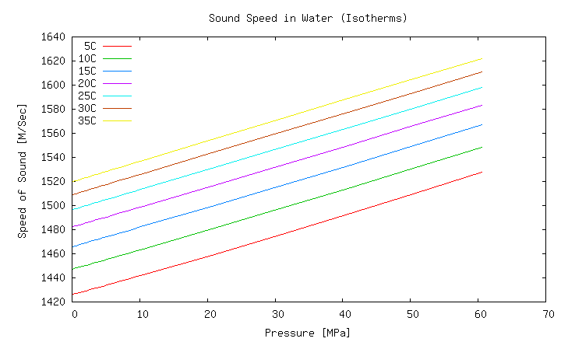
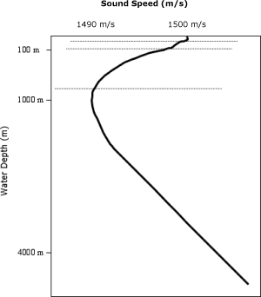
BEHAVIOR OF UW ACOUSTICS
Sound is a mechanical oscillating pressure
Speed of sound is dependent on the medium
Underwater speed of sound is not same for all frequencies
Notes:
Sound be it sonic or ultrasonic, is a mechanical oscillating pressure that causes particles of matter to vibrate as they transfer their energy from one to the next. These vibrations produce relatively small changes in pressure that are propagated through a material medium. In comparison to atmospheric pressure, these pressure variations are very small and about tenths of micro Pascal. As explained in last slide, sound is characterized by its amplitude i.e. relative pressure level, intensity i.e. the power of wave transmitted in a particular direction in watts per square meter, frequency and propagation speed. Speed of sound is dependent on the medium, in which it is travelling. Underwater speed of sound, particularly seawater, is not the same for all frequencies, but varies with aspects of the local marine environment such as density, temperature and salinity. For example, in air the speed is approximately 330 m/s at normal temperatures, and less at lower temperatures. In water, mainly due to the greater “stiffness” of seawater relative to air, sound travels at approximately 1500 m/s but this speed is affected by temperature, salinity and pressure.

Slide 67
FACTORS AFFECTING UW TARGET DETECTION
Detection of wanted signal against unwanted noise
Wanted signal is acoustic energy generated or reflected by the target
Unwanted background can be either
  Sea Noise
  Ship Noise
Detection depends
upon SNR
Notes:
The basic detection problem in underwater acoustics is that of detecting a wanted signal against unwanted background noise. The wanted signal is the acoustic energy generated or reflected by the target. The unwanted background can be either reverberations created by unwanted reflected energy, noise inherent in the propagation medium or ambient noise known as ‘Sea Noise’ or noise associated with the equipment used for detection and the platform on which it is mounted ‘Ship Noise’. Detection of a wanted signal against an unwanted background, only takes place when signal to noise ratio (SNR) is either equal or greater than the Threshold Level which is expressed logarithmically in decibels.

Slide 68
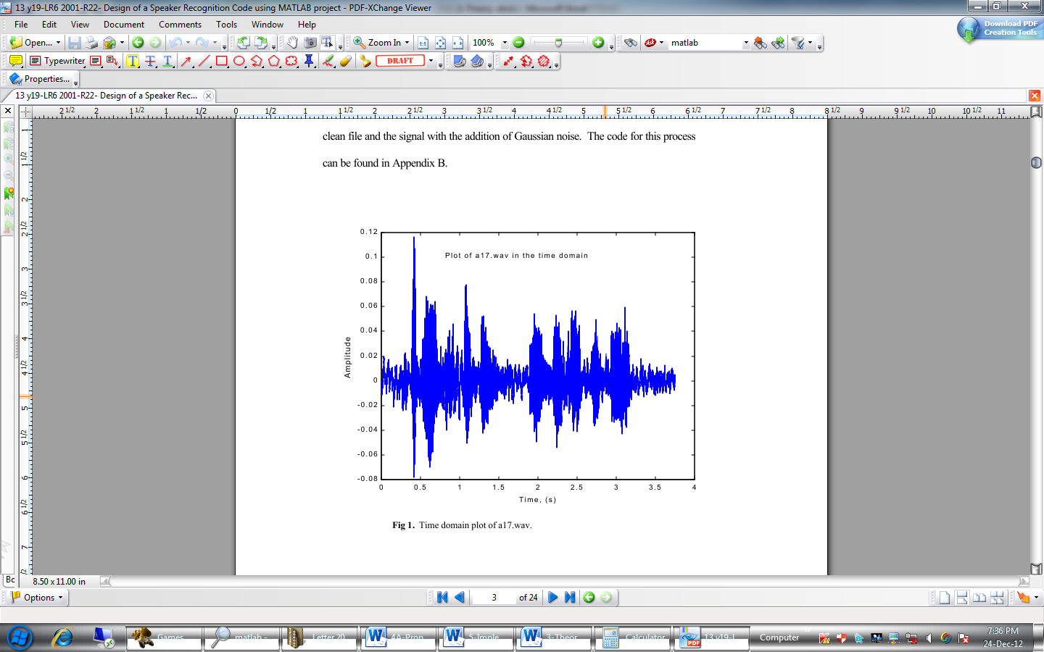
TIME DOMAIN FEATURES
    Simple Feature Extraction
Very low Computational requirement
Suffers from ecological noise
Short Time Energy, Zero Crossing Rate or Percentage of low Energy Frames
Notes:
Time domain feature generation is the simplest domain. This domain has an added advantage to offers very low computational requirement demand. Conversely, the features extracted in time domain often suffer from the ecological noise effects. Short time energy, zero crossing rate and percentage of low energy frames are commonly used time domain features for classification.

Slide 69
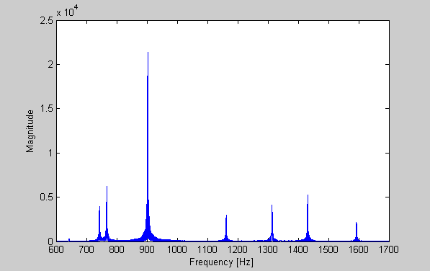
FREQUENCY DOMAIN FEATURES
    Most commonly used for classification
  Assumption of a stationary spectrum
  Peaks detection, loudness and spectral representations are the few commonly extracted features in frequency domain
Notes:
Frequency domain is the most commonly used in classification processes for feature generation. Frequency domain feature generation algorithms, works with the assumption of a stationary spectrum in a given time. Peaks detection, loudness and spectral representations are the few commonly extracted features in frequency domains. The Fourier transform is used to retrieve the frequency content of a signal in the frequency domain.

Slide 70
T-FRQUENCY DOMAIN FEATURES
    Short Time Fourier Transform
      Reduces the non-stationary signal behavior
      Maps a signal into a two dimensional function of frequency and time
      Provides a better spectral power characterization of the signal over time
      Very high computational complexity
      Compromise between time and frequency resolutions
Notes:
Unlike Time and Frequency domains, which provide some useful information but lack due to their one-dimensional approach, Time-Frequency domain techniques provide two dimensional functions of time and frequency.
Under the time frequency domain, Short Time Fourier Transform was introduced in 1946 to resolve the issue pertains to Frequency domain. Based on quantum mechanics the physicist proposed STFT which implement small frame sizes and reduce the non-stationary signal behavior. Short Time Fourier Transform (STFT) is a classical case for implementation of the linear transform for feature extraction. STFT differs from FFT in terms that the signal in the STFT is manipulated with a sliding window function. This means that it actually exploited the fact that though signal may not be completely stationary over complete time period but it is stationary over a very short period of time. With STFT frequency contents of a signal can be obtained over time scale. In other words STFT maps a signal into a two dimensional function of frequency and time; as indicated on the slide. The STFT provides a better spectral power characterization of the signal over time. However, time-frequency domain has a major drawback of very high computational complexity.
Time-Frequency domains transforms minimize the spectral interference between adjacent frequency components. These transforms yield a combine function of time and frequency that represents the energy density of the signal concurrently in both time and frequency scales. Thereby correcting the main drawback of non-time resolution with the standard Fourier transform. However, the main drawback associated with STFT is that the STFT of a given signal depends expressively on the parameters that are used for its evaluation or in other words there is a compromise between time and frequency resolutions.

Slide 71
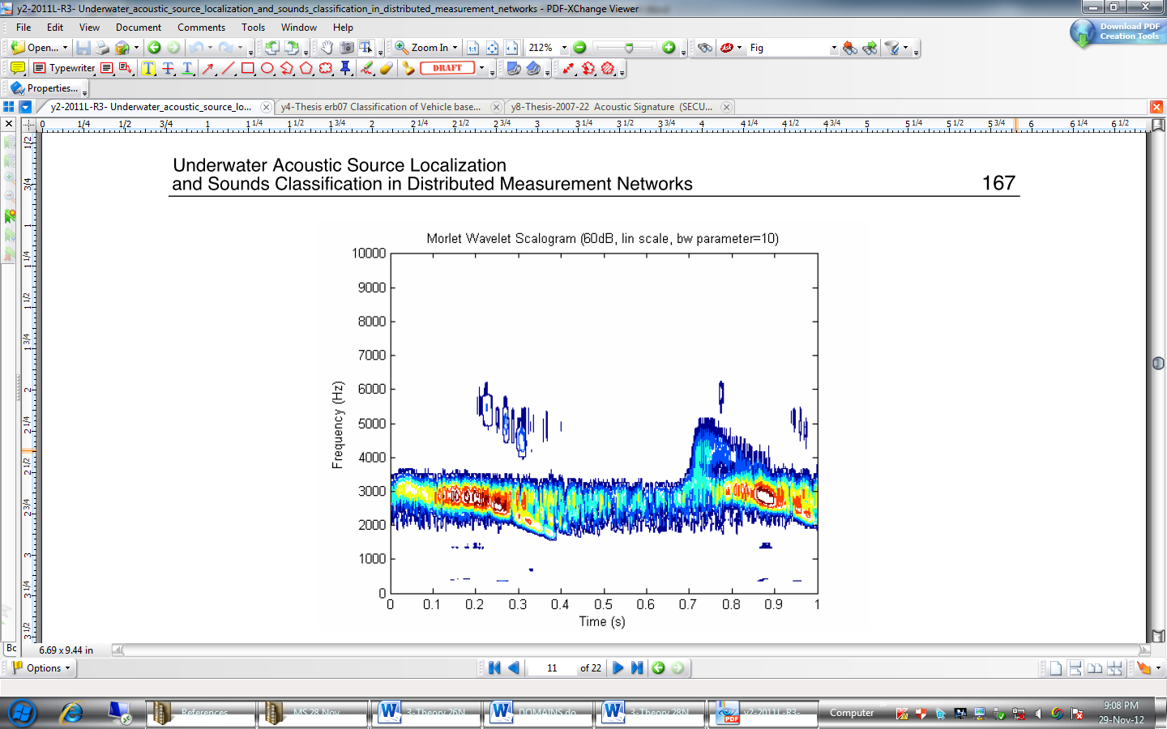
T-FRQUENCY DOMAIN FEATURES
  Wavelet Transforms
    Overcome the drawback of non-time resolution
    Provide efficient information extraction capability without any resolution compromise
    Good to detect signals’ trends, breakdowns and sharp peaks variations
    Useful to perform signals’ compressing and de-noising with minimal distortion
Notes:
Under the Time-Frequency domain the second technique is Wavelet transform. Being the classes of functions, wavelets are appropriate for the analysis of wide spectrum of signals. Wavelet transform is a generalization of Fourier transform which provides both spatial and frequency localization of a given signal. Wavelet can be understood as the classes of a wave-like functions; often irregular, non-symmetric and which has no analytical/mathematical expression. They allow function expression in orthogonal, non-orthogonal or redundant structures. Wavelet analysis is capable to localize feature of a signal analysis in both time and frequency. Unlike, previously discussed Fourier based transforms; Wavelets base techniques decomposed the signal in multiple components thorough applying different scales and time shifts to a base function. This base function is usually known as the mother wavelet function. With the lowering of mother wavelet scale, wavelet transform gives an increased knowledge of the high frequency components of the signal through lower number of signal’s samples contained in each scaled mother wavelet. Wavelets capability of efficient information extraction and coding allowed their successful utilization in system modeling and control, image and signal processing, data compression, communication, signal identification, pattern recognition and feature extraction. Unlike STFT, in wavelet transform there is no compromise between time and frequency resolutions. Moreover, wavelets are particularly interesting to detect signals’ trends, breakdowns and sharp peaks variations, and also to perform signals’ compressing and de-noising with minimal distortion.

Slide 72
PRPOPOSED METHODOLOGY AND ITS IMPLEMENTATION
  Selection of Classification Approach
Supervised Approach
Unsupervised Approach
Combined/Hybrid Unsupervised and Supervised Approach
Notes:
Coming to the most important part of my presentation i.e. proposed methodology and its implementation to undertake the thesis work. As earlier said, the core objective of my thesis is to develop a suitable mechanism which can classify the received underwater ultrasonic signal with respect to material of mine. This objective required selection of a suitable method which provides maximum possible confidence for identifying the material of mine from which these ultrasonic signals are reflected back.

Slide 73
SELECTION OF CLASSIFICATION APPROACH
  Supervised Approach
      Provides user defined classes which are assigned after cross verification
      Training data assists in classification of classes with least difference
      Method tends to be more reliable and produce more accurate results
Notes:
In supervised learning methodology a trained representative set of feature vectors, against all classes, is used for classifier training or learning. The method provides user defined classes which are assigned after cross verification. Therefore use of training data assists in classification with least difference. Moreover, supervised learning method tends to be more reliable and produce more accurate results.

Slide 74
SELECTION OF CLASSIFICATION APPROACH
  Unsupervised Approach
      More suitable in case of high-dimensional data and hierarchical feature representations
      Does not suffice the aim of this thesis
Combined/Hybrid Unsupervised and Supervised Approach
Notes:
Grouping of data with similar feature is used in unsupervised training. Clustering or vector quantization algorithms use unsupervised training where features vectors are clustered around some centre locations. The method does not suffice the aim of this thesis where correct identification is required against the available information. Conversely, unsupervised learning is more suitable in the case of high-dimensional data and hierarchical feature representations.
Combined supervised/unsupervised training is the combination of both supervised and unsupervised methods. In these types of classifiers, initially internal clustering is formed through unsupervised training and then subsequent labels are assigned to these clusters through supervised learning.

Slide 75
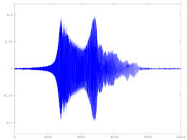
MOTIVATION
Ultrasonic sonar sophisticated technology
MTC was involved to ensure uninterrupted availability
MTC had to undertake cyclic overhauling and systematic indigenous replacement
Need for acquisition of actual ultrasonic signals
Notes:
As I have already mentioned in introductory slide that I belong to Pakistan Navy. During my career in navy I was appointed onboard an MCMV to perform the duties of Weapon Engineering Officer, and was primarily responsible for upkeep and maintenance of weapons and sensors including ultrasonic sonar DUBM-21D. Being a sophisticated and relatively newer technology, the repair and maintenance of this sonar remained problematic. Though, me and my staff were not practically involved in mine hunting operations and evolutions but use of sonar for these operations was a must and some of the times mine hunting operations had to be abandoned due some problem in sonar. To ensure the uninterrupted availability of this sonar system, Maritime Technologies Complex commonly known as MTC was involved by PN and a multimillion dollar contract, spanned over 17 years, was signed between MTC and PN. According to this contract MTC had to undertake cyclic overhauling of all sonar systems onboard MCMVs along with systematic indigenous replacement of problematic modules and arrays. The purpose of presenting this information here is that during the discourse of my literature review, need for acquisition of actual ultrasonic signals was felt sternly.

Slide 76
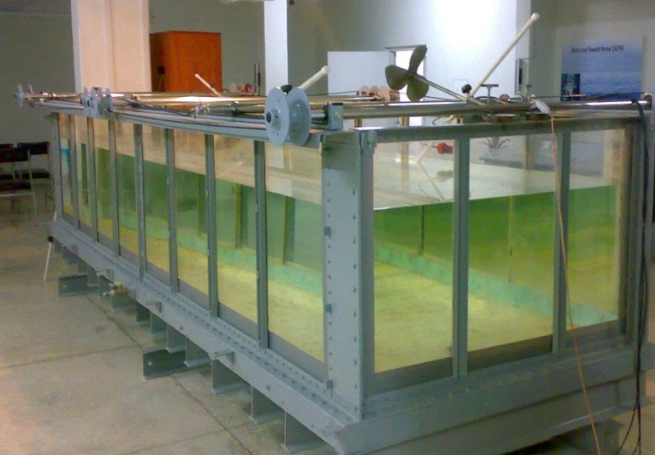
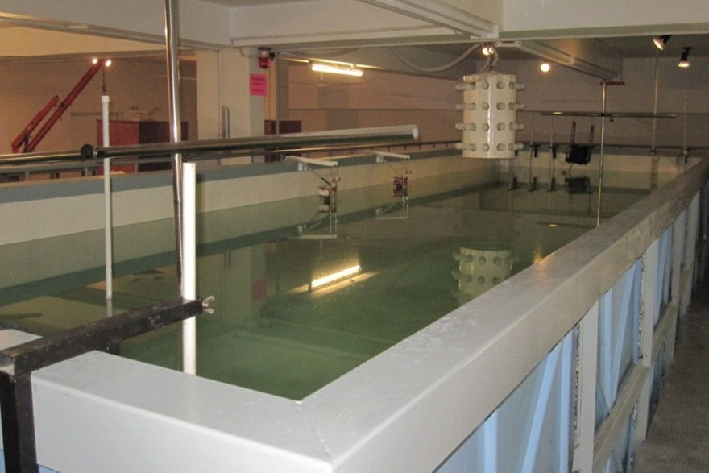
MOTIVATION
UW System Simulation Lab at WE School of PNS KARSAZ and MTC
MTC liked the idea of classification of sonar echoes
MTC team to provide the required data and interested in using the research results
Notes:
Accordingly, different avenues including Under Water System Simulation Lab at WE School of PNS KARSAZ and MTC were contacted. The sonar simulation lab at PNS KARSAZ did not prove helpful but upon discussion with MTC sonar project team, the idea of classification of sonar echoes w r t mine material was appreciated. MTC team not only promised to provide the required data but also desired that the outcome of thesis may be shared with them so that they can use it in indigenous development of MCMV sonar systems.

Slide 77


MOTIVATION
Cdr Dr Tariq Mairaj PN is an NDT expert
Need and availability of expertise and data motivated to investigate efficacy
Acquired ultrasonic sonar data was read for its efficacy
MCMV sonar data uploaded onto computer system 1st time in PN
Notes:
Additionally, my supervisor, Cdr Dr Tariq Mairaj PN is an NDT expert and has practically developed and implemented classification algorithms for ultrasonic NDT signals. Therefore, the need and availability of expertise as well as required data motivated me to investigate efficacy of ultrasonic classification methods onto active ultrasonic sonar signals. The ultrasonic sonar data was acquired with the help of MTC and was read for its efficacy. I feel no hesitation in saying that this the first time in Pakistan Navy that ultrasonic data of an MCMV based sonar system has been uploaded onto a computer system for processing purposes. Now it was the time to decide upon the objective and scope of the thesis.

Slide 78
ACQUISITION OF UW SIGNALS
MCMVs fitted with short range ultrasonic sonar namely DUBM-21D
DUBM-21D has separate detection and classifier arrays
Classifier
Array
Detector
Array
SONAR DUBM-21D

Slide 79
ACQUISITION OF UW SIGNALS
An MCMV with basic detection and classification ranges
Notes:
The pictorial understanding of the experimental setting for acquiring the actual ultrasonic sonar signals is depicted on slide. Both arrays of sonar operate at different frequencies hence different ranges. The primary detection of mine or object is conducted on detection array at a relatively longer range. After acquiring an echo from an underwater object on detection array, the classification of object in “mine like or not” is done with the help of classification array. Practically the classification array operates on relatively higher centre frequency then the detector array to obtain better resolution. The higher centre frequency of classification array results in relatively shorter range for classification operation. This in-turn makes the classification operation prone to risks.

Slide 80
ACQUISITION OF UW SIGNALS
Placed at a distance of approx 1500 meters in partly submerged condition
Placement of objects is well outside the classification range
Echoes from detection array captured through AD converter
23 Inch
35 Inch
The basic dimensions of metal
and GRP objects
Notes:
The acquisition of ultrasonic signals from this sonar onboard an MCMV was undertaken for 02 cylindrical mine like objects of metal and GRP, which were specially fabricated for the purpose. Both the objects had same shape and equal dimensions (diameter 23 Inches and height 35 Inches). The fabricated objects were placed in detection range of sonar one after the other at a distance of approximately 1500 meters in partly submerged condition to behave like floating mine. It was ensured that placement of objects is well outside the classification range of sonar. The returning echoes from detection array of sonar were captured from both the objects for same duration of time through an analogue to digital converter and with the help of Maritime Technologies Complex (MTC). Prior to the capturing of sonar signals from floating objects, ambient echoes were also acquired for same duration of time. The data acquisition was conducted while the ship was stationary in sea and sea state was calm.

Slide 81



GEC COMMITTEE
Cdr Dr Faisal Amir PN
Cdr Dr Sajid Saleem PN
Dr Bilal Kadri
Notes:
I am also grateful to the respected GEC for sparing their valuable time for my support and guidance during the course of my thesis.

