Slide 1

In The Name of
ALLAH ALMIGHTY
The Most Merciful, The Most Beneficent

Slide 2
Impact Response Analysis of Reinforced Concrete Beam under Falling Weight Impact Load
UG CE 2010, Structures
Instructor : Asst. Professor Mansoor Khalid
School of Civil and Environmental Engineering (SCEE)
National University of Sciences & Technology (NUST)
Islamabad, Pakistan
Notes:
We designed this template so that each member of the project team has a set of slides with its own theme. Members, here’s how you add a new slide to just your set:
Mark where you want to add the slide: Select an existing one in the Thumbnails pane, click the New Slide button, then choose a layout. The new slide gets the same theme as the other slides in your set.
Careful! Don’t annoy your fellow presenters by accidentally changing their themes. That can happen if you choose a different theme from the Design tab, which changes all of the slides in the presentation to that look.

Slide 3

Group Members
Rao Muhammad Waqar
Bilal Lal Khan
Syed Kumail Raza Naqvi (G.L)
Syed Furqan Haider
Imtisal Afzal

Slide 4
Introduction
Yield Theories
Experimental Overview
Test procedure
Results
Analytical Overview
Conclusion
Scaling
Why to scale?
FEM
LS-DYNA
Modeling
Comparison
Validation
Theories
results
Recommendation
Remarks

Slide 5
INTRODUCTION

Slide 6
Scope
To study the behavior of RCC beams under variable impacts
Verification of the FEM model by comparison with experimental results
Apply these results to other similar structures to assess their performance in impact loads
To study the direct application of similarity laws (scaling laws) on impact events

Slide 7
Impact Force

Slide 8
What is an impact force?
Impact is a high force or shock applied over a short time period when two or more bodies collide
The effect depends critically on the relative velocity of the bodies to one another
Mechanism of impact load is based on conservation of energy and momentum
Some common cases of impact loadings are
Rock fall due to avalanches, volcanic eruption or earthquakes
Huge stones and trees coming with water during the floods hazard
Vehicle collision with a traffic barrier
Fragments striking after bomb blasts

Slide 9
Yield Criterion

Slide 10
Yield Criterion
FEM analysis was carried out by using
Von Mises Yield Criterion
Drucker-Prager Yield Criterion

Slide 11

Von Mises Yield Criterion
In an elastic body subjected to a system of loads in 3 dimensions, a complex 3 dimensional system of stresses is developed
It is a pressure independent formula for calculating whether the stress combination will cause failure
A formula for combining 3 principal stresses into an equivalent stress, which is then compared to the yield stress of the material
The equivalent stress is often called the “Von Mises Stress”

Slide 12
Drucker-Prager Yield Criterion
It is a pressure dependent model for determining whether a material has failed or undergone plastic yielding
In terms of the equivalent stress and the hydrostatic stress, it can be expressed as
Here σe is the equivalent stress, σm is the hydrostatic stress, and a, b are material constants

Slide 13


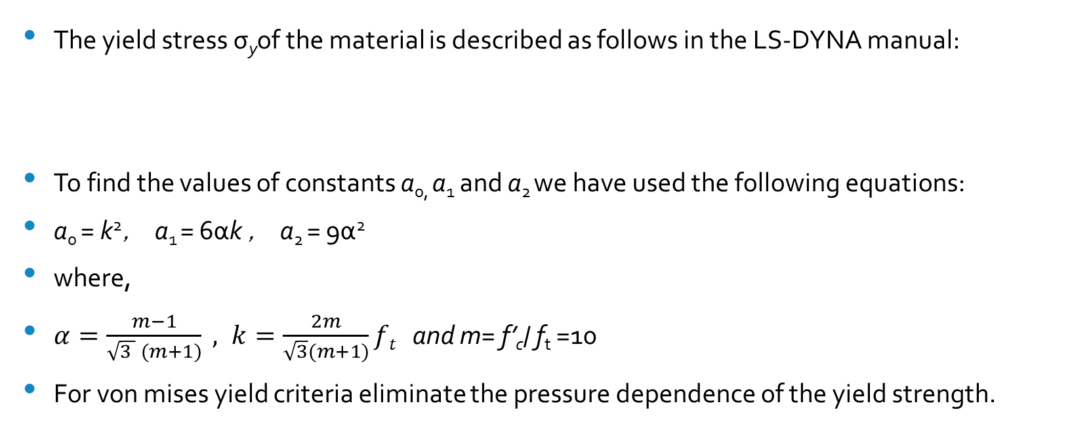
Input Parameters For The Failure Theories
The yield stress σ_{y}of the material is described as follows in the LS-DYNA manual:
To find the values of constants a_{0,} a₁ and a₂ we have used the following equations:
a₀ = k²， a₁ = 6αk ， a₂ = 9α²
where,
$α=\frac{m−1}{\sqrt{3 } (m+1)} , k=\frac{2m}{\sqrt{3}(m+1)}ft$and m= f’_{c}/ f_{t} =10
For von mises yield criteria eliminate the pressure dependence of the yield strength.

Slide 14
Finite Element Modeling

Slide 15
FINITE ELEMENT MODELING
An alternative to hand calculations or extensive testing of components
Provides very accurate solutions to difficult and complex problems of complicated geometries
Economical as compared to experiments as testing and prototyping is very costly
For the present investigation LS-DYNA is chosen for the impact modeling

Slide 16
LS-DYNA
LS-DYNA is a general purpose finite element code for analyzing the large deformation dynamic response of structures.
It is specifically suitable for crash analysis involving high velocity impact events similar to hammer impact on short beams.
LS-DYNA enables to simulate tests or working conditions, virtual environment before manufacturing prototypes of products.
LS-DYNA also can work integrated with other used engineering software on desktop by adding Auto-CAD and ANSYS connection modules.

Slide 17
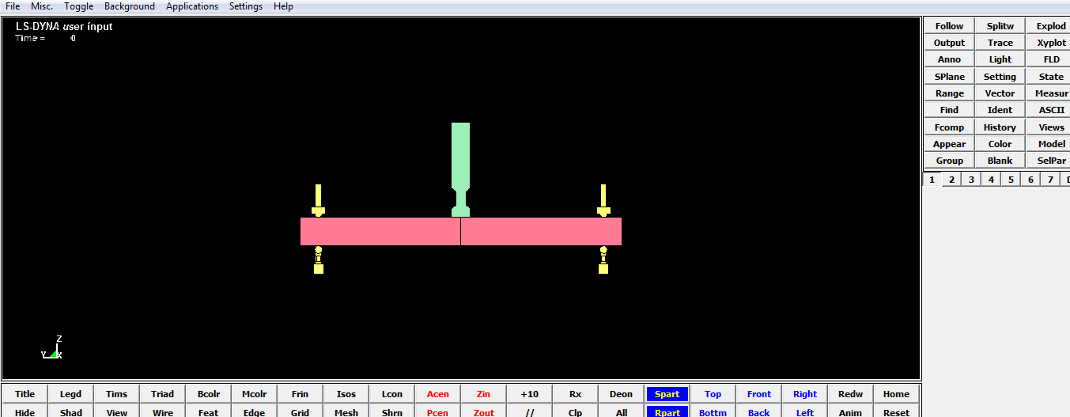

Slide 18
Experimental Overview

Slide 19
Falling Weight Impact Test Procedure
The Reinforced Concrete beam is supported with pin supports
a drop hammer of 400kg steel.
impact was imposed at the center of beam.
drop hammer velocity is used as V=7m/s.
Impact force and reaction force for the experiment was measured using load cell.
The displacement was observed with help of laser type LVDT
Notes:
Linearly variable displacement trasducer

Slide 20
List of Static Design Values
Main reinforcement ratio % | Shear Span ratio a/d | Static shear Capacity Vu_{sc} (kN) | Static bending Capacity Mu_{sc} (kNm)
1.1 | 3.75 | 162.8 | 69.7
Material Properties of Concrete
Elastic Coefficient (MPa) | Compressive strength (MPa) | Poisson’s Ratio V
25.4 * 10³ | 31.2 | 0.177
Material Properties Rebar
Rebar | Yield strength (MPa) | Elastic Coefficient (GPa) | Poisson’s ratio V
#8 | 379 | 206 | 0.3
#3 | 373 | 206 | 0.3

Slide 21
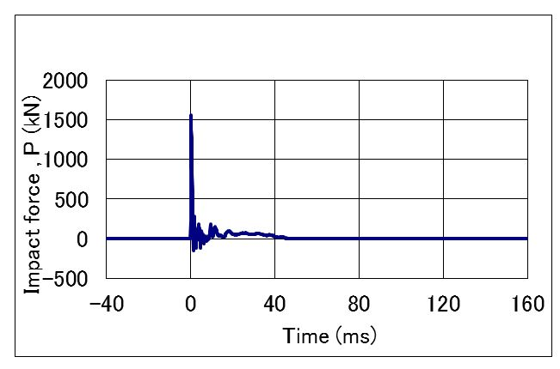
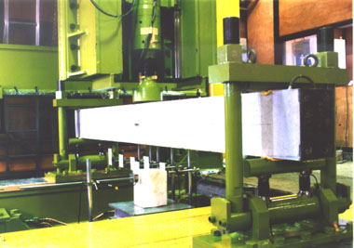
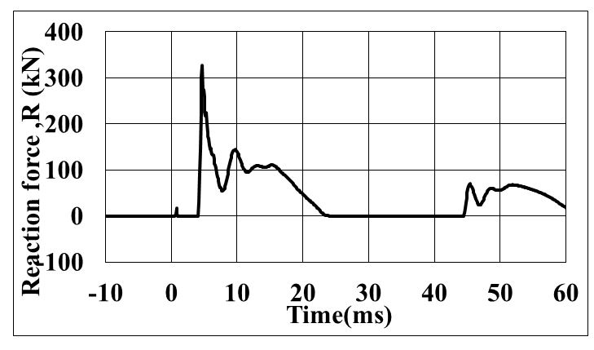
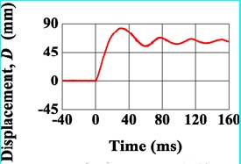
Impact Force
Reaction Force
Displacement
Experimental Results

Slide 22
Analytical Overview

Slide 23
Analytical Overview
To set up a research technique capable of estimating and simulating the impact response of the RC beam
Made a prototype model in the LS-DYNA
Performed the numerical analysis to the impact experimental case

Slide 24
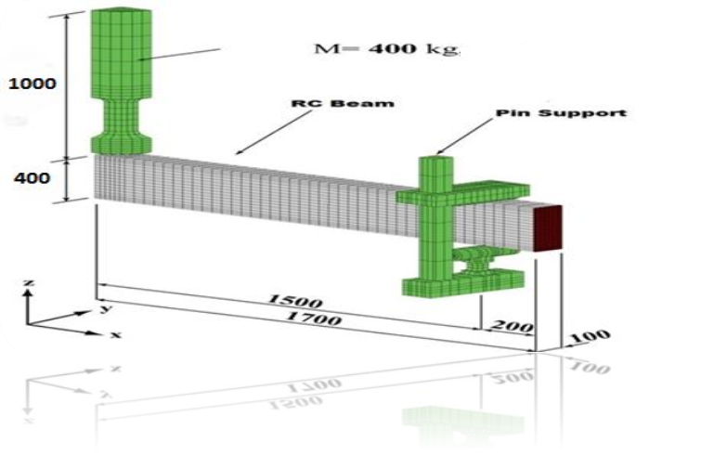
FE Model
Quarter of the beam was modeled

Slide 25
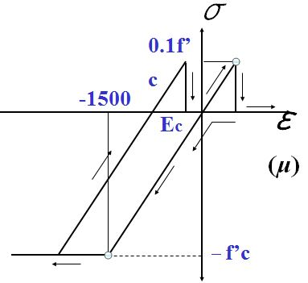
Concrete
The compressive strength f’c is equal to the compressive stress
At failure point the compressive strain is equal to 1500 µ strain
The compressive strength is ten times the tensile strength

Slide 26
Comparison Between Time Histories of Displacement, Reaction Force and Impact Force at Mid-span

Slide 27
Displacement at mid-span

Slide 28
Reaction Force

Slide 29
Impact Force

Slide 30
The difference in the numerical results is listed below
Case | Velocity | Von Mises | Drucker Prager | Experiment | Difference b/w V and E | Difference b/w D and E
Max Displacement | 7 | 74.72 | 97.97 | 76.22 | -1.5 | +21.75
Impact Force | 7 | 1508.904 | 2033.62 | 1501.01 | -1.196 | +523.52
Reaction Force | 7 | 403.02 | 322.97 | 320.12 | +82.9 | +2.85

Slide 32
Result summary for variable velocities
Experimental was conducted at velocity of 7 m/s
After the verification of analytical results with experiment, we generated results for different velocities
Results against the two theories for these velocities are shown in the next slide

Slide 33
Case | Velocity (m/s) | Drop Hammer Height(m) | Max Displacement (mm) | Max Impact Force (kN) | Max Reaction Force (kN) | Target Kinetic Energy (kJ)
Von mises | 7 | 2.49 | 74.72 | 1508.904 | 403.02 | 12.37
Drucker prager | 7 | 2.49 | 97.97 | 2033.62 | 322.97 | 22.05
Experiment | 7 | 2.49 | 76.22 | 1510.01 | 320.12 | 15.43
Von mises | 6 | 1.83 | 58.19 | 1199.534 | 379.32 | 12.25
Drucker prager | 6 | 1.83 | 78.44 | 1246.234 | 279.71 | 14.025
Von mises | 5 | 1.27 | 42.99 | 1166.406 | 341.19 | 8.78
Drucker prager | 5 | 1.27 | 59.43 | 475.726 | 235.62 | 8.09
Von mises | 4 | 0.81 | 29.99 | 760.01 | 286.05 | 3.81
Drucker prager | 4 | 0.81 | 43.11 | 282.04 | 191.34 | 4.57
Von mises | 3 | 0.45 | 18.63 | 417.308 | 216.65 | 3.16
Drucker prager | 3 | 0.45 | 28.64 | 80.8942 | 146.72 | 2.76
Von mises | 2 | 0.20 | 10.57 | 598.364 | 145.04 | 1.39
Drucker prager | 2 | 0.20 | 15.88 | 488.74 | 101.45 | 1.90
Von mises | 1 | 0.05 | 3.75 | 390.274 | 72.60 | 0.76
Drucker prager | 1 | 0.05 | 6.61 | 299.332 | 54.81 | 0.63

Slide 34
V = 6 m/s

Slide 35
V = 5 m/s

Slide 36
V = 4 m/s

Slide 37
V=3 m/s

Slide 38
V = 2 m/s

Slide 39
V = 1 m/s

Slide 40
Effect due to change in Compressive Strength of Concrete (f_{c}’)
Ultra High Strength Concrete (80MPa)
High Strength Concrete (60MPa)
Medium Strength Concrete (31.2MPa)
Type | Compressive Strength (MPa) | Unit Weight (kN/m3) | Elastic Modulus (MPa)
Ultra High Strength Concrete | 80 | 42.87 | 106827
High Strength Concrete | 60 | 39.69 | 106827
Medium Strength Concrete | 31.2 | 23 | 25400

Slide 41
Effect due to change in Compressive Strength of Concrete (f_{c}’) (Continued…)
Variation in displacement for different compressive strengths is very small
A significant increase in Impact force is seen as the compressive strength of concrete increases
Reason being, greater the density of concrete greater will be the absorption energy thus greater will be the damping

Slide 42
Displacement

Slide 43
Impact Force

Slide 44
Scaling

Slide 45
Scaling
Scaling is a linear transformation that enlarges or shrinks the actual size of an objects by a scale factor.
If the scale factor is greater than 1, scaling is called dilation or enlargement
When the scale factor is a positive number smaller than 1, scaling is called contraction.

Slide 46
Why to scale?
Generalizing the model for real world applications
To find out the limits up to which our analytical model is valid in real world
To provide results for similar beams common in industry

Slide 47
Scaling Approaches
Theories on which scaling is based are
MLT
Calladine
To achieve a perfect similarity Buckingham Pi Theorem is used

Slide 48
Buckingham Pi Theorem
According to the theorem the dimensionless quantities in the model and the prototype must match. The number of dimensionless quantities can be found from the following equation:
P = n – k
n represents variables and k represents the number of independent dimensions occurring in those variables

Slide 49
β_{V}: Initial Velocity Factor
β_{G}: Impact Mass Factor
β_{V}: Initial Velocity Factor
β_{G}: Impact Mass Factor
 | β_{V}⁽¹⁾ | β_{G}⁽²⁾
MLT | 1 | S³
Calladine | S | S

Slide 50
Parameters | Scale Factor (S)
Dimension (height, thickness) | S
Area | S²
Volume | S³
Linear Displacement | S
Moment of Inertia | S⁴
Frequency | S-^{1/2}
Density | S_{E}/S
Point Load | S_{E}.S²
Line Load | S_{E}.S
Uniformly Distributed surface Load | S_{E}
Shear force | S_{E}.S²
Moment | S_{E}.S²
Stress | S_{E}
Notes:
Korean Society of Civil Engineers (KSCE)

Slide 51
Limitations
The Calladine and MLT approach do not take account of
Strain rate effect.
Material difference between prototype and model.
Moment of inertia “I”.

Slide 52
SCALING THE IMPACT WITH DIFFERENT MOMENT OF INERTIA
Results for Scaled Up Model (scale factor=S=3)
Prototype
H=0.4m
B=0.6m
L=3.4m
Scaled Model
H=1.2m
B=0.6m
L=10.2m
Decrease in the mid span displacement due to the effect of moment of inertia

Slide 53
SCALING THE IMPACT WITH CONSTANT MOMENT OF INERTIA OF RC BEAM

Slide 54
Displacement for 6.4m span

Slide 55
Displacement for 4.6m span

Slide 56
Conclusion
The impact analysis can be done using LS-DYNA effectively
The model can be further simplified by taking advantage of its symmetry which will reduce the computational time in the analysis
The classical Mass-Length-Time basis and the Calladine theory purpose the scaling factor for initial conditions of the structures under severe dynamic loads
For constant moment of inertia the deflection of scaled up models increase where as varying moment of inertia has an inverse relation with the displacement of RC beams

Slide 57
Recommendations
We have used simply supported beam for impact analysis. For future work analyze the RC beam using different types of supports
We used LS-DYNA for analysis, verify the result using other FEM software.
In scaling, Callidine theory defines velocity factor and makes strain rate effect equal to unity, for future work, distort velocity factor so as to compensate strain rate effect
The difference in inertia of model was not considered for impact force analysis but plays an important role, it should be considered in future work

Slide 58


Any Questions?

Slide 59


